Slide 1

Dr. Hedgewar pustakalay sah sewa samitee Laxminagar, Bhachhi
PRESENTS
ACHIEVEMENTS
1991-2024

Slide 2
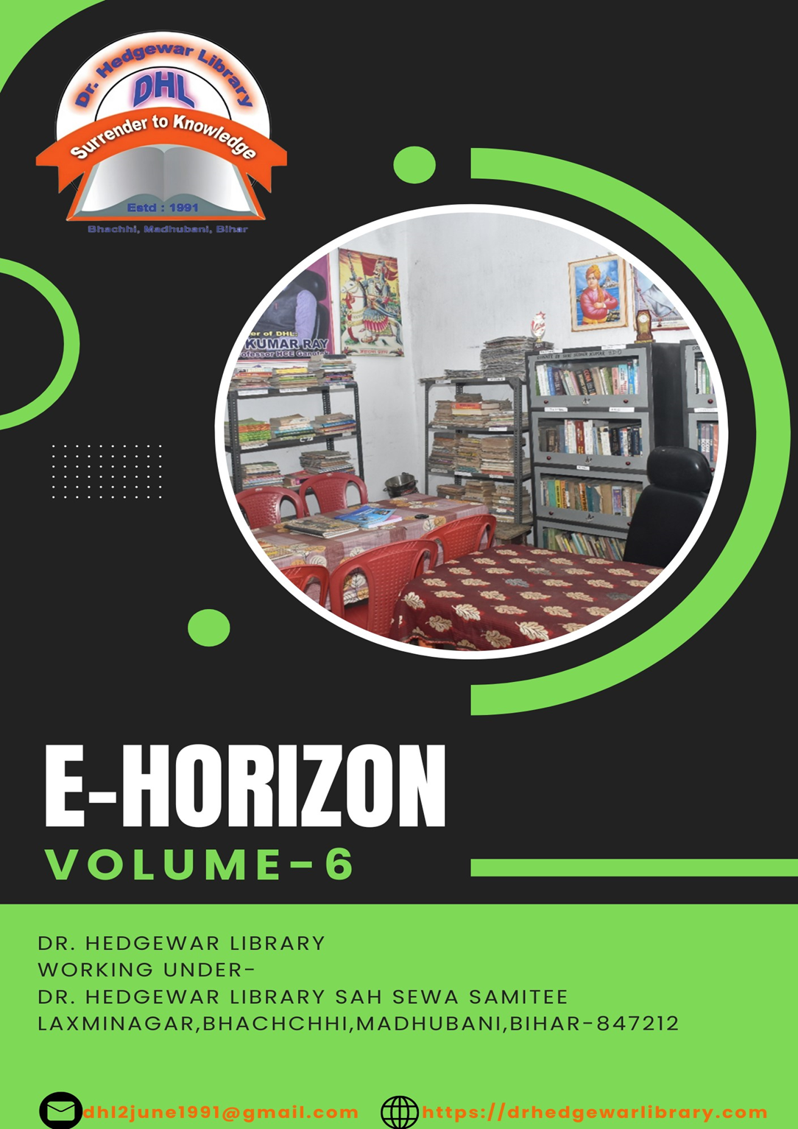

Slide 3
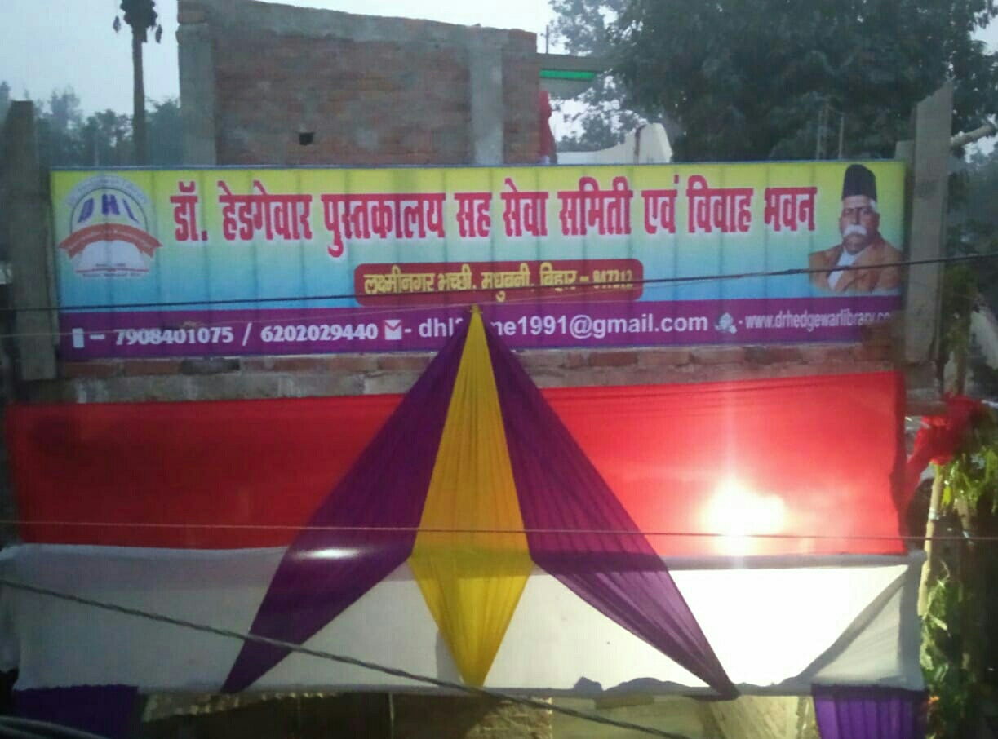
ONLINE COMPETITION & CELEBRATION OF 34th FOUNDATION DAY 2ND JUNE 2024

Slide 4
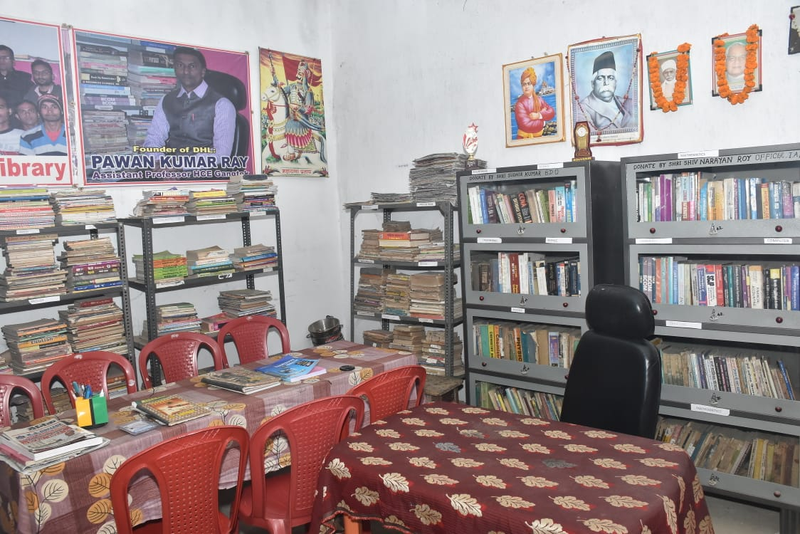
An inside view of our library which features Our founders MEMBERS and our achievers
Activities from 1991 to 2024

Slide 5
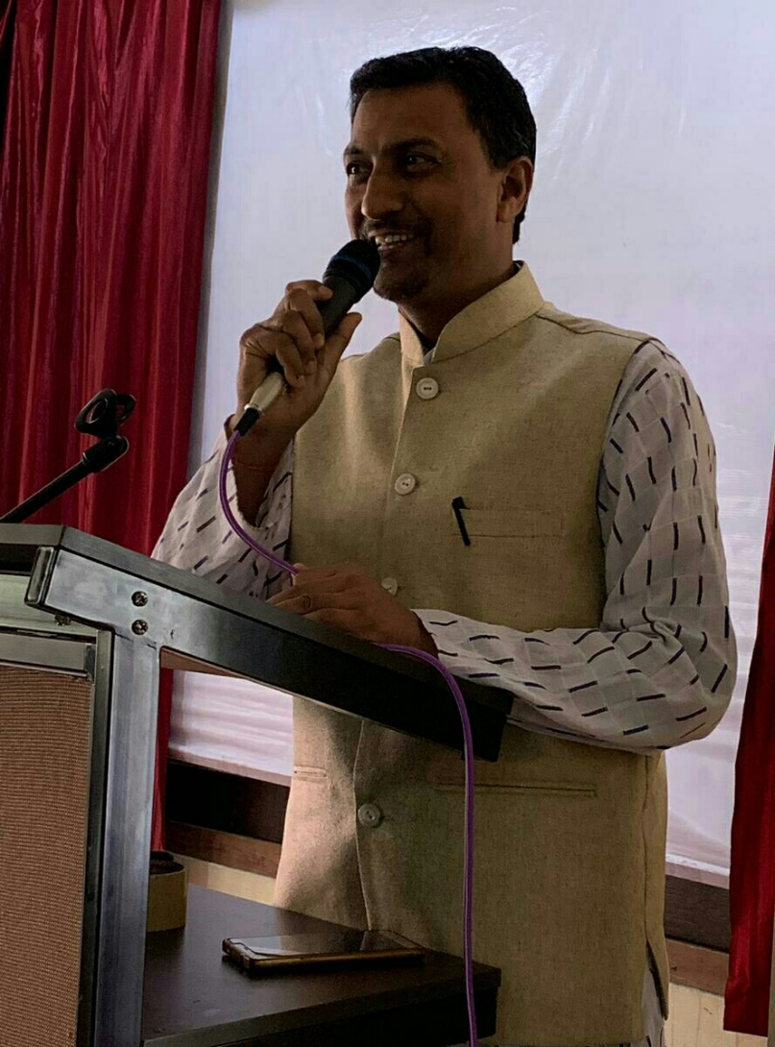
Principal Founder: Pawan Kumar Ray

Slide 6
Founder members:
1.Lalit Kumar (Business Man)
2.Pradeep Ray (Hardware Engineer)
3.Mahesh Kumar (Business Man)
4.Hiralal Ray (Business Man)

Slide 7
NEW
COMMITTEE MEMBERS

Slide 8
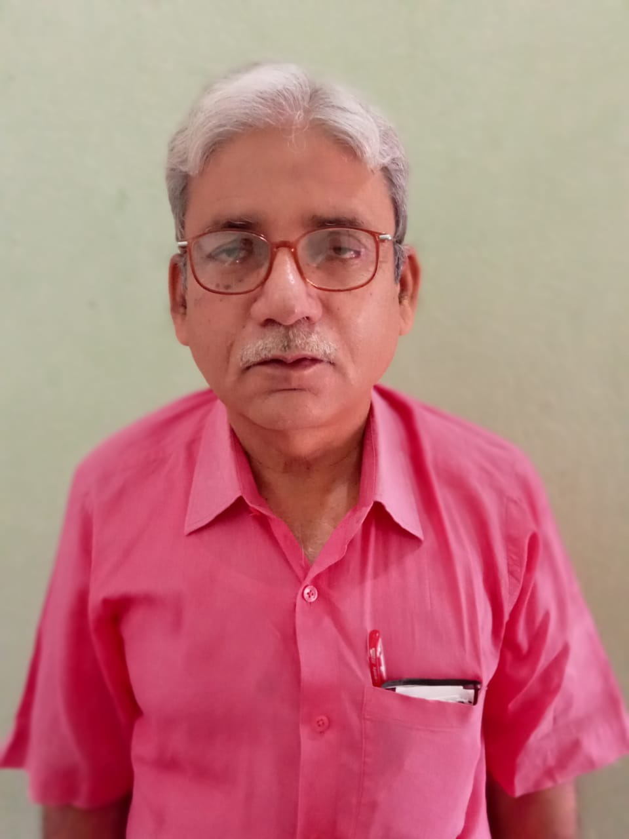
MD. KAMRAN PRESIDENT

Slide 9
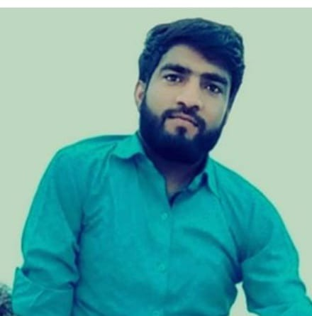
MR. Mahavir kumar (Secretary)

Slide 10
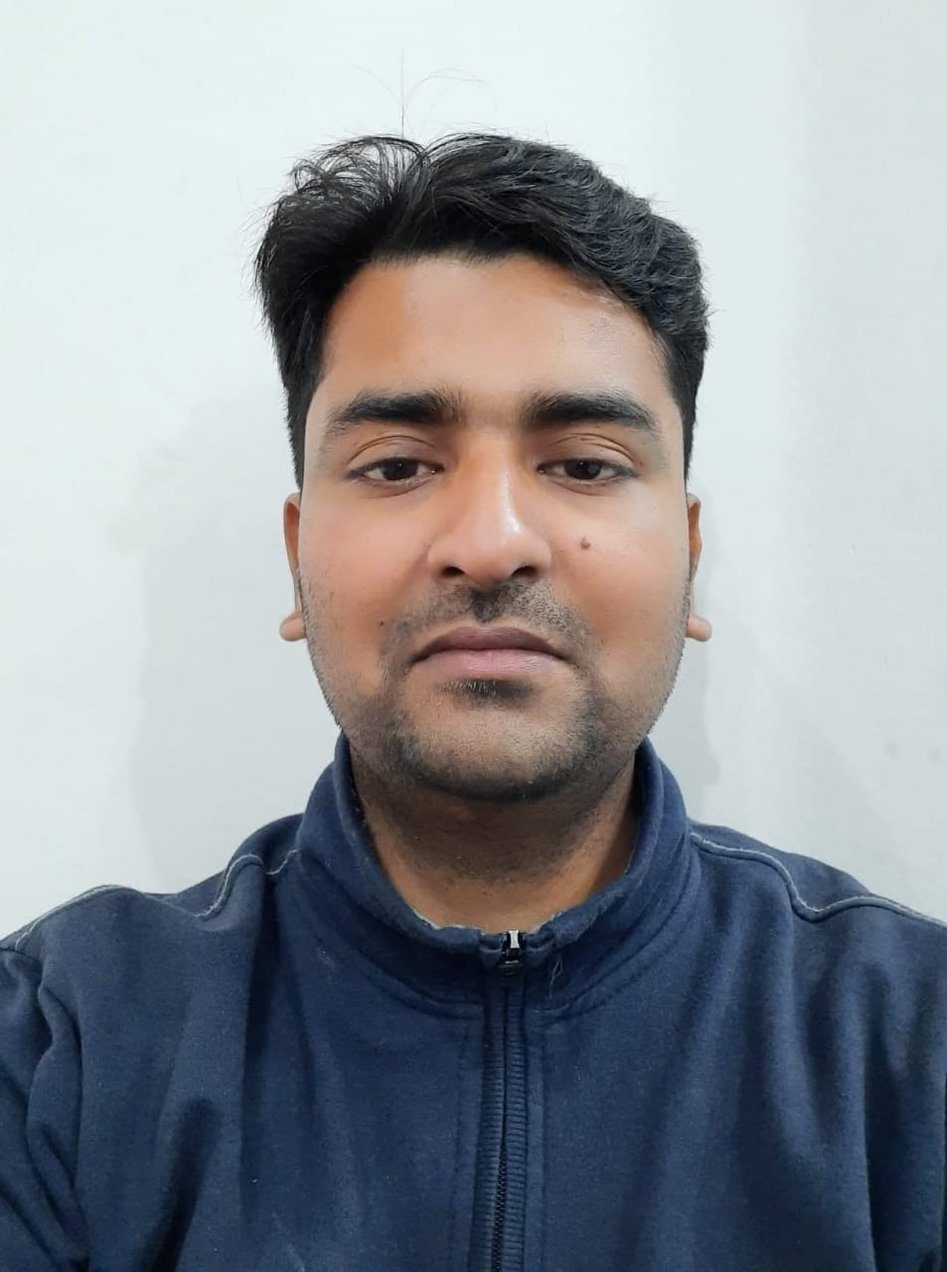
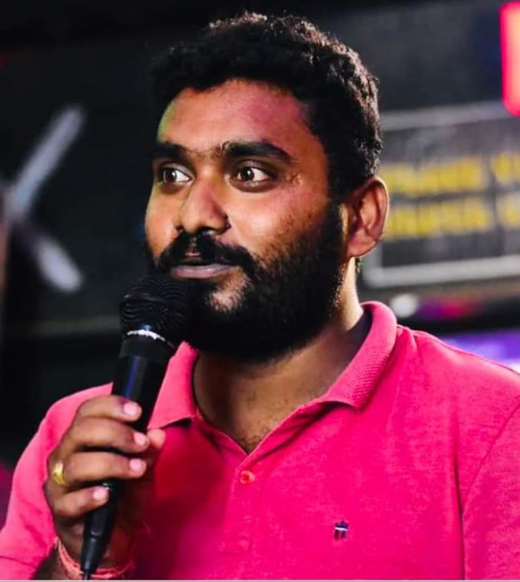
MR. Abhijit kumar (program & media coordinator)

Slide 11
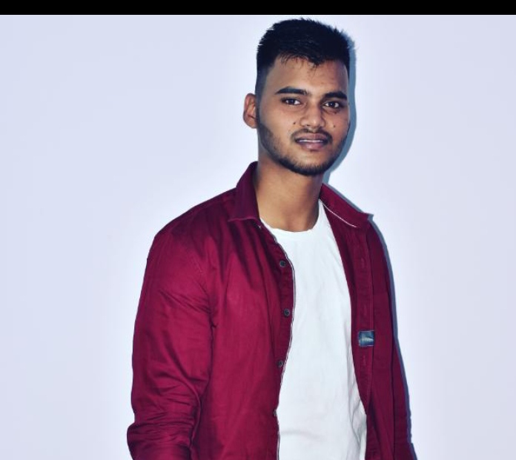
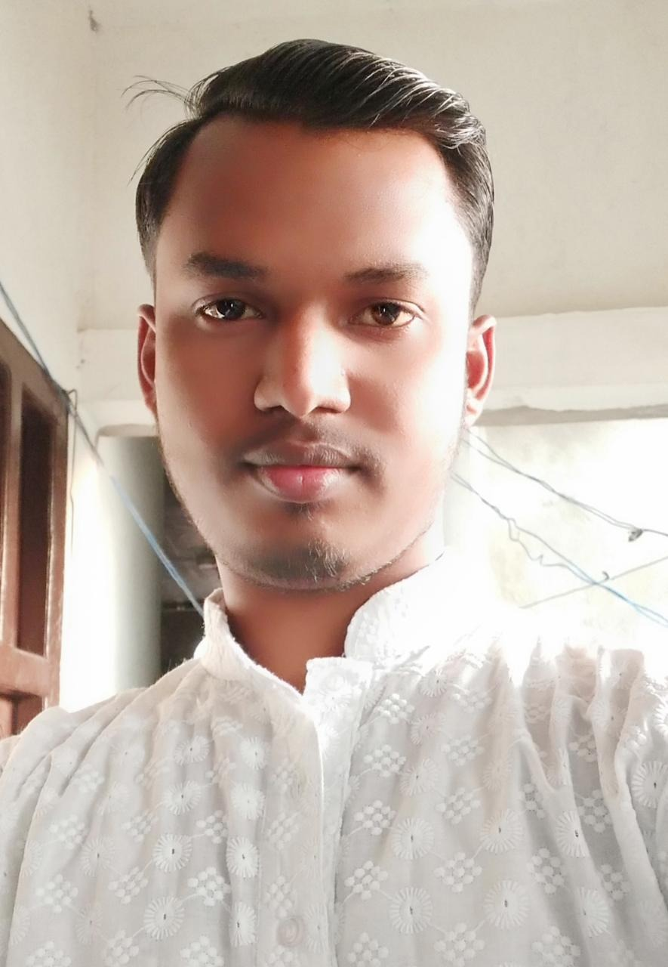
MR. Bhagwant ji MAndal (Treasurer)

Slide 12
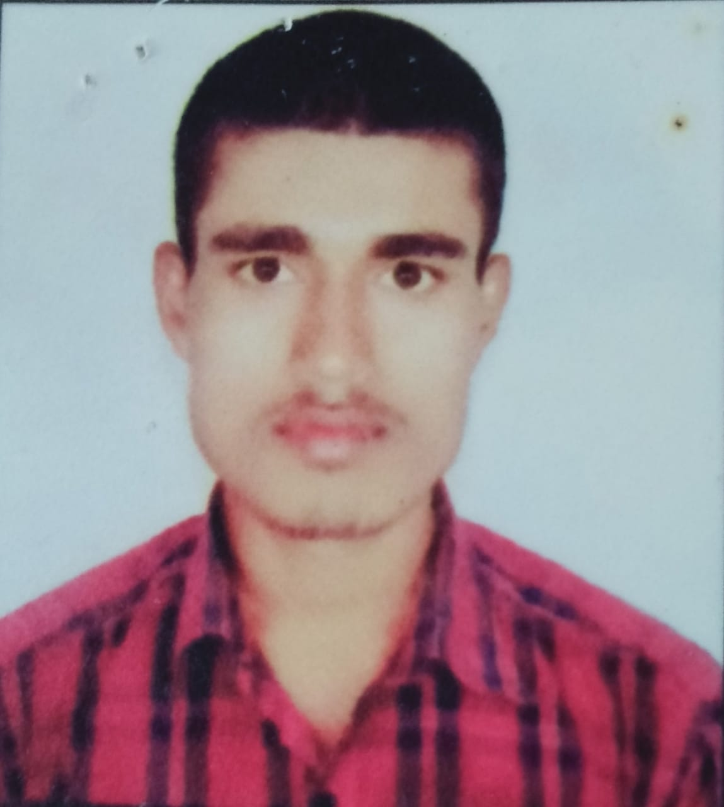
MR. Pappu kumar (coordinator)

Slide 13
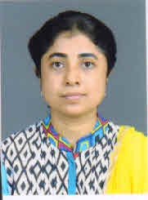
Ms.Pallavi Bhowmik EDITOR of e-MAGAZINE

Slide 14
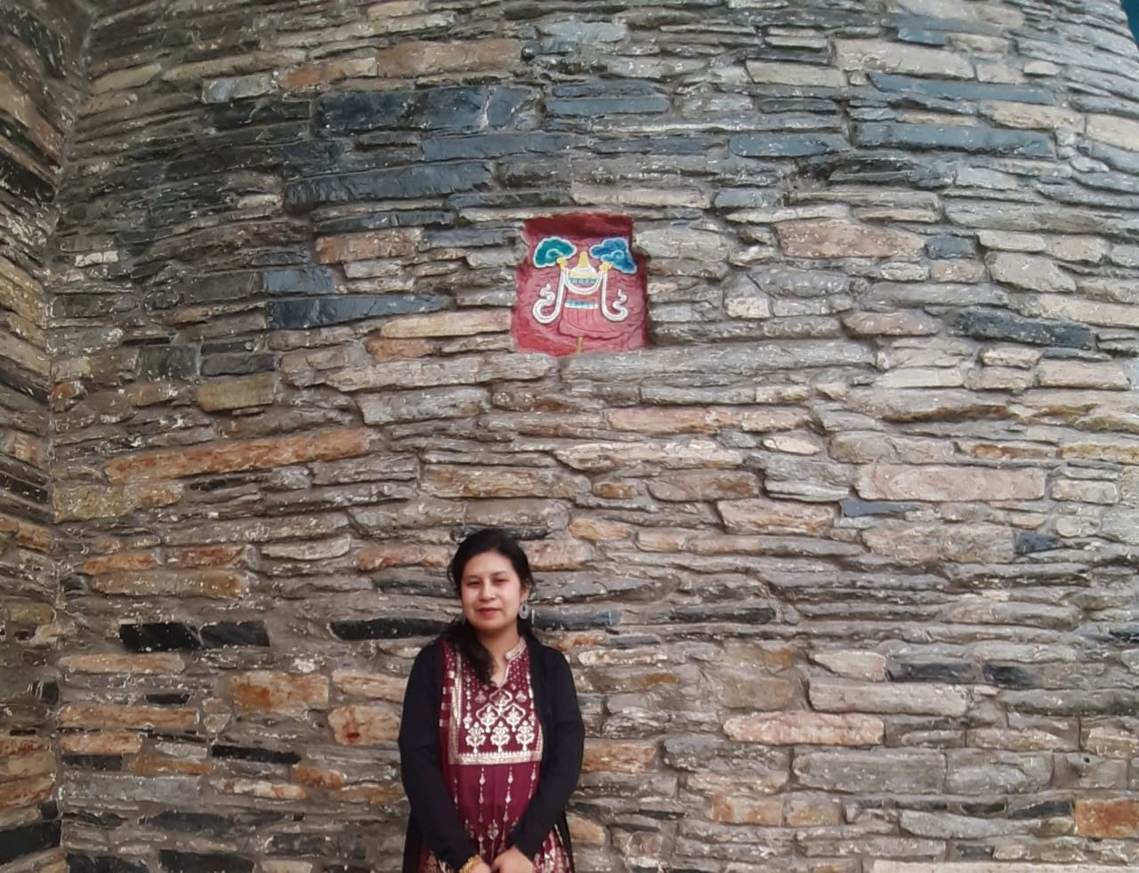
Ms. Minsang Tamang Co-ordinator of e-MAGAZINE

Slide 15
Mentors
Dr. Hedgewar Library

Slide 16
Md.Kamran principal R.P.D.j Higher secondary school jitwarpur madhubani

Slide 17
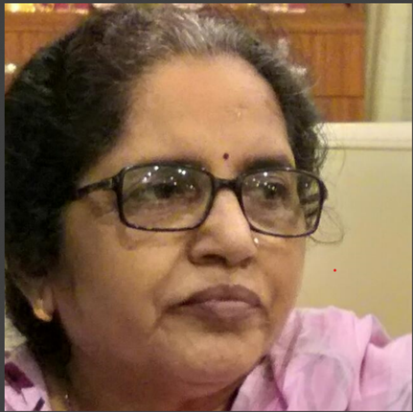
Mrs. Gita Mishra Retd.Headmistress, Wattson Middle School, Madhubani

Slide 18
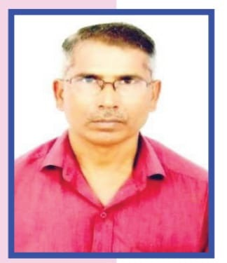
Shri. Shiv Narayan Ray MASTER Warrant Officer, Indian Air force

Slide 19
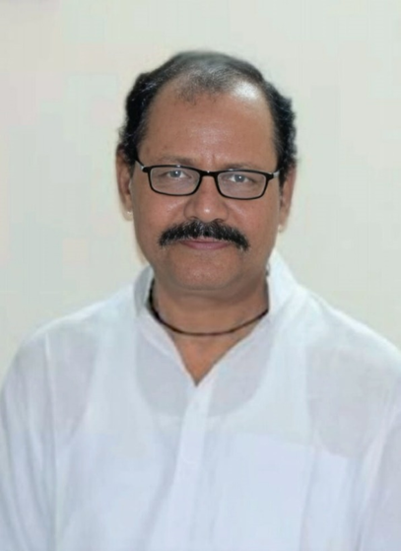
Late Arun Kumar Sinha Bank Officer SBI,Madhubani

Slide 20
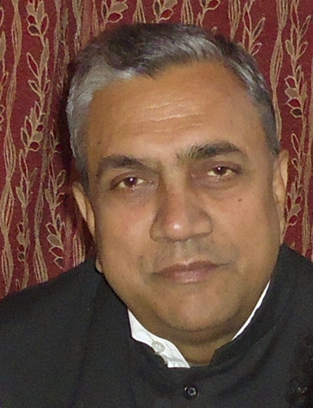
Late Arun Kumar Mishra Coe & Professor, RK College,Madhubani

Slide 21
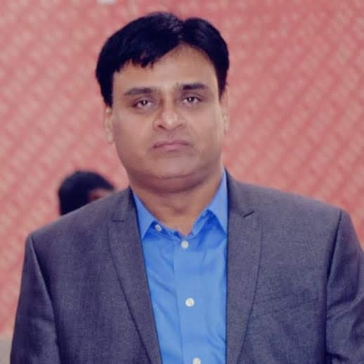
Kishore Kumar Zonal Head DCB Bank Bhopal

Slide 22
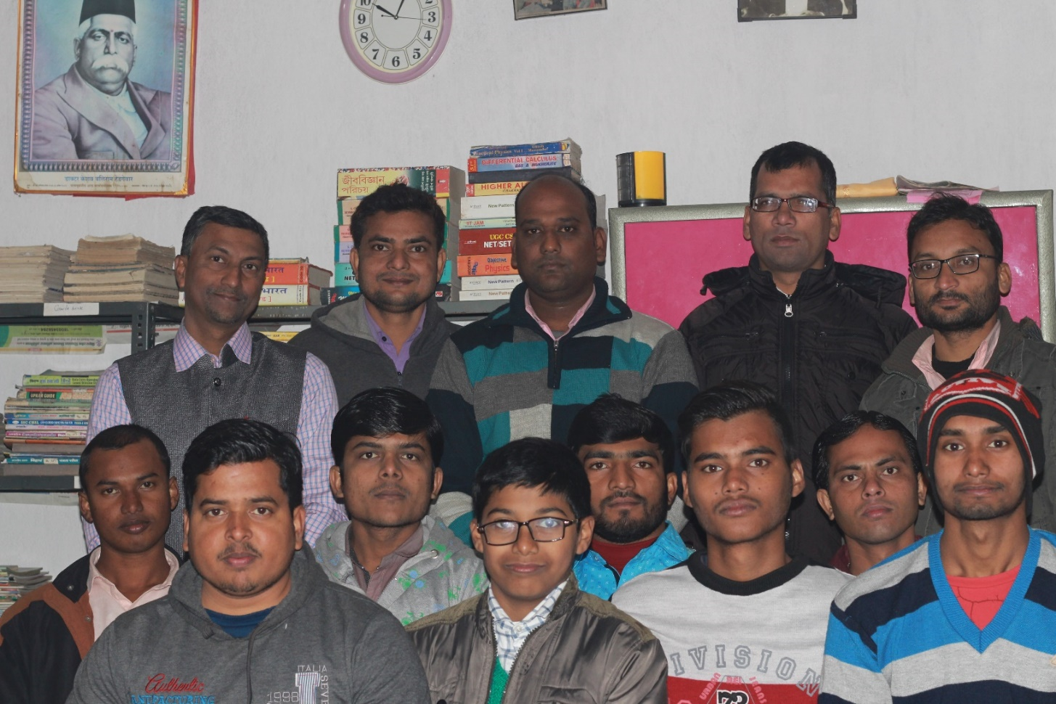
Members of THE Library

Slide 23
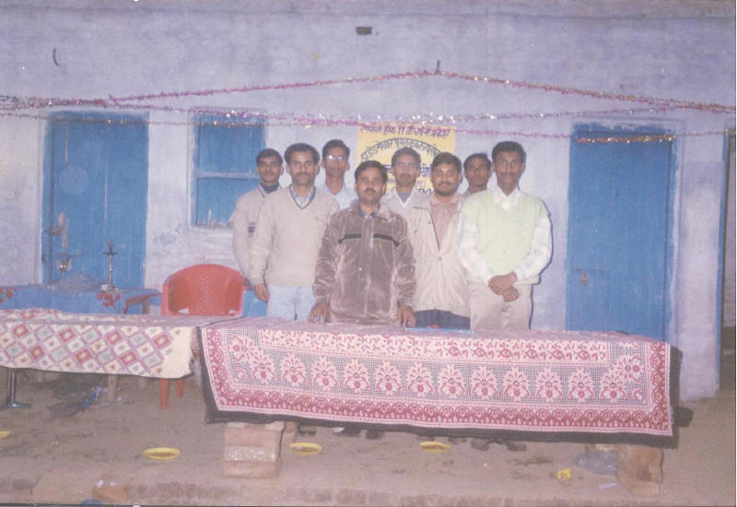
Our Earliest members

Slide 24
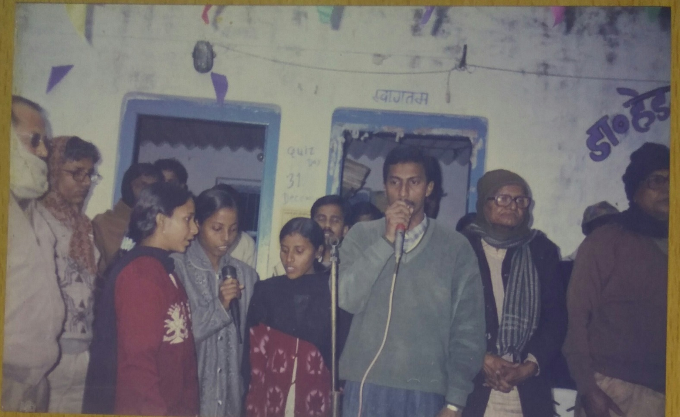
INAUGURAL Quiz contest in 1995

Slide 25
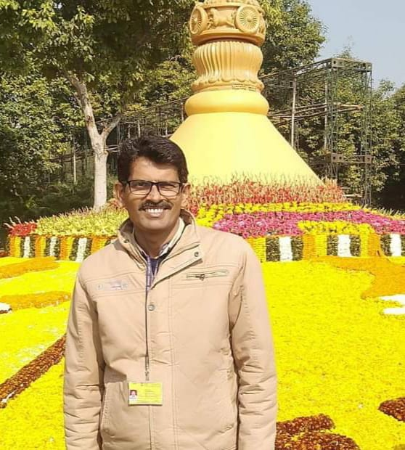
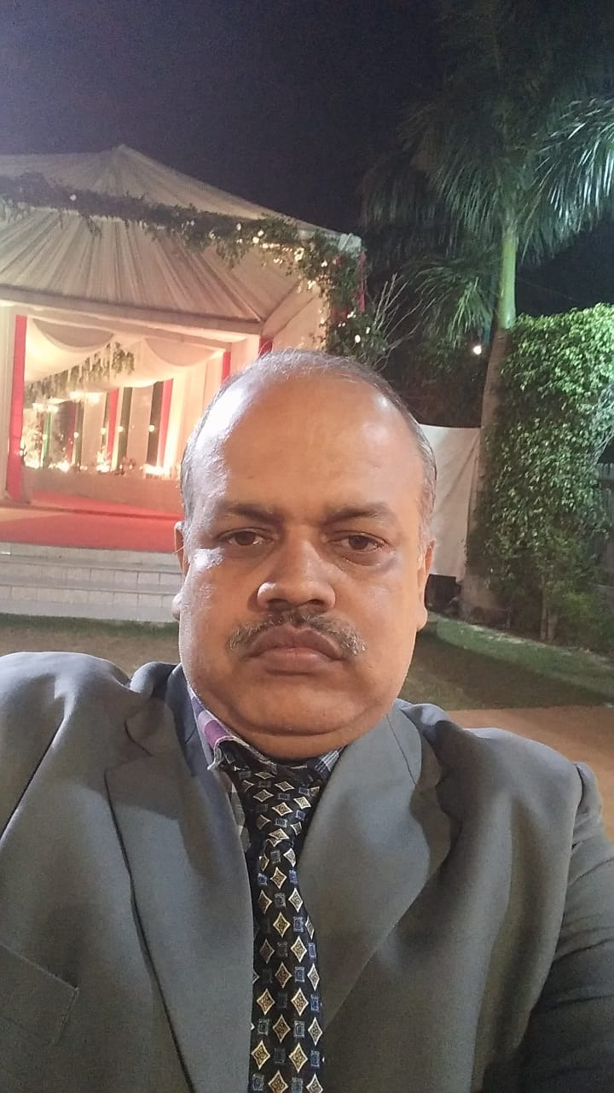
First winner of QUIZ CONTEST AMITABH PRASAD & Shambhu nath singh employee of central govt.of india

Slide 26
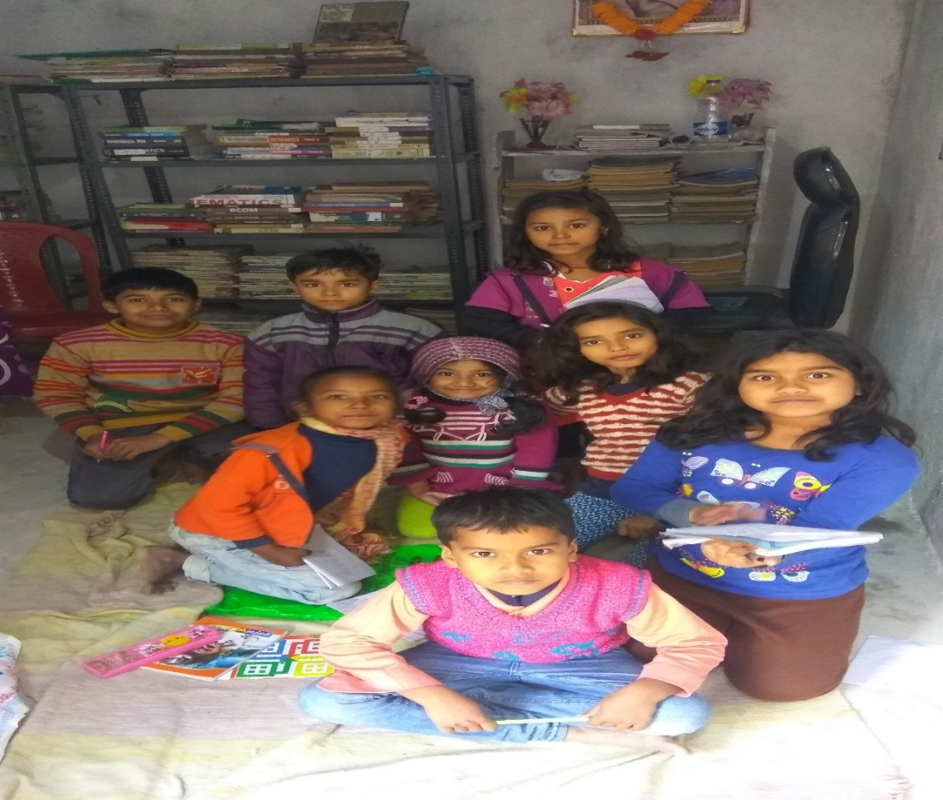
Little Children in our library

Slide 27
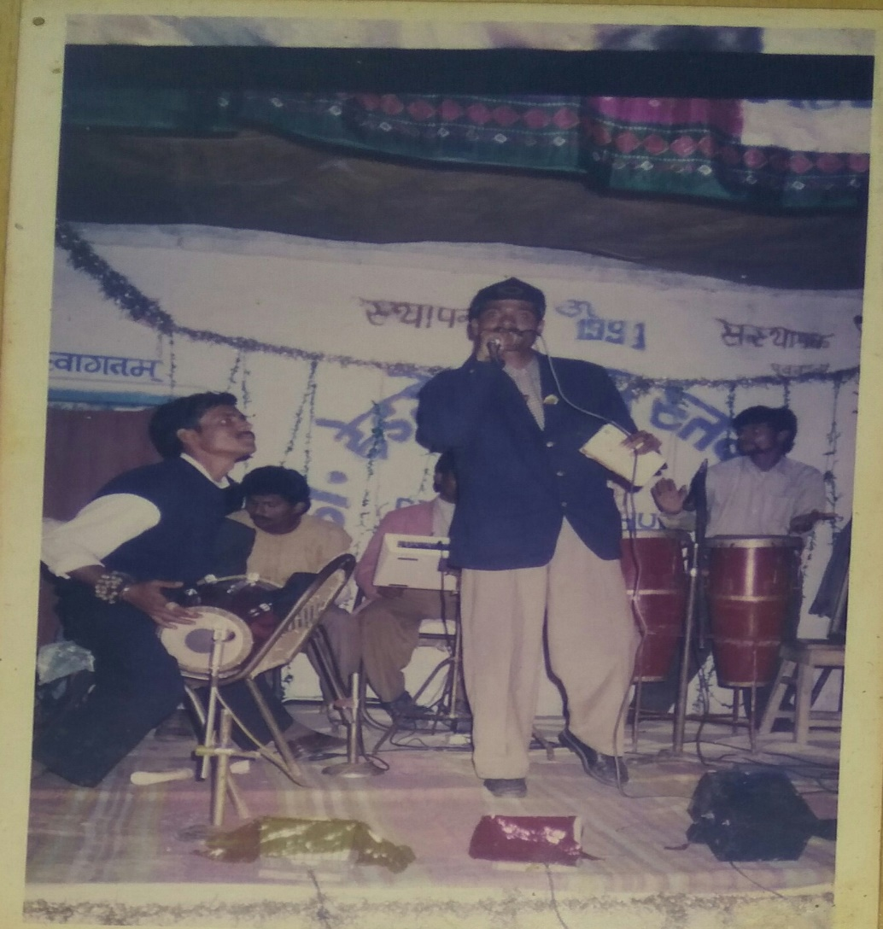
A Cultural program in our library in 1995

Slide 28
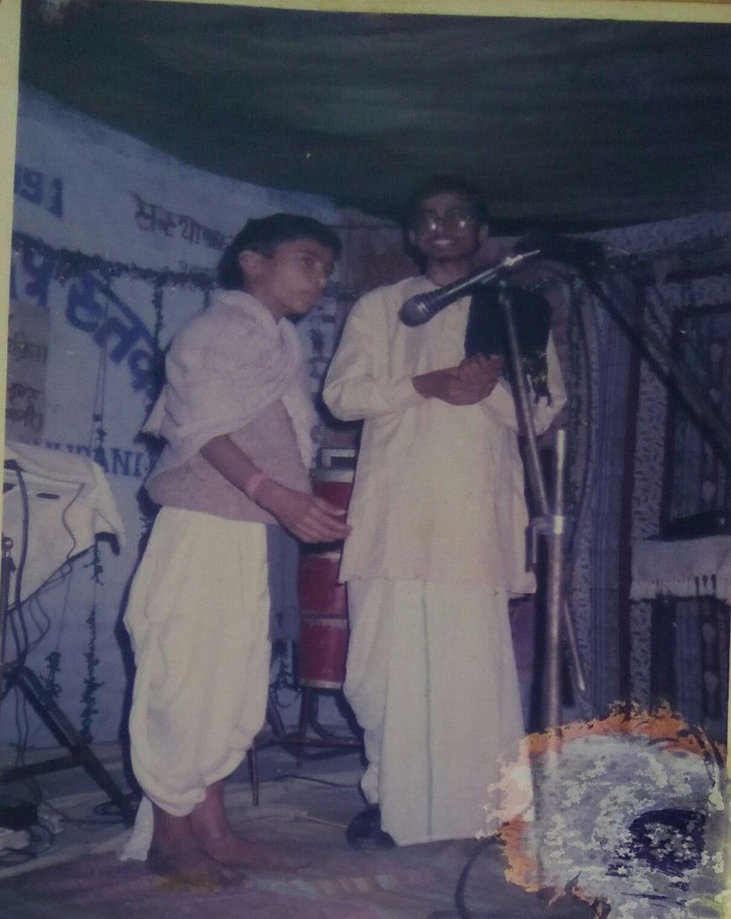
Skit by members

Slide 29
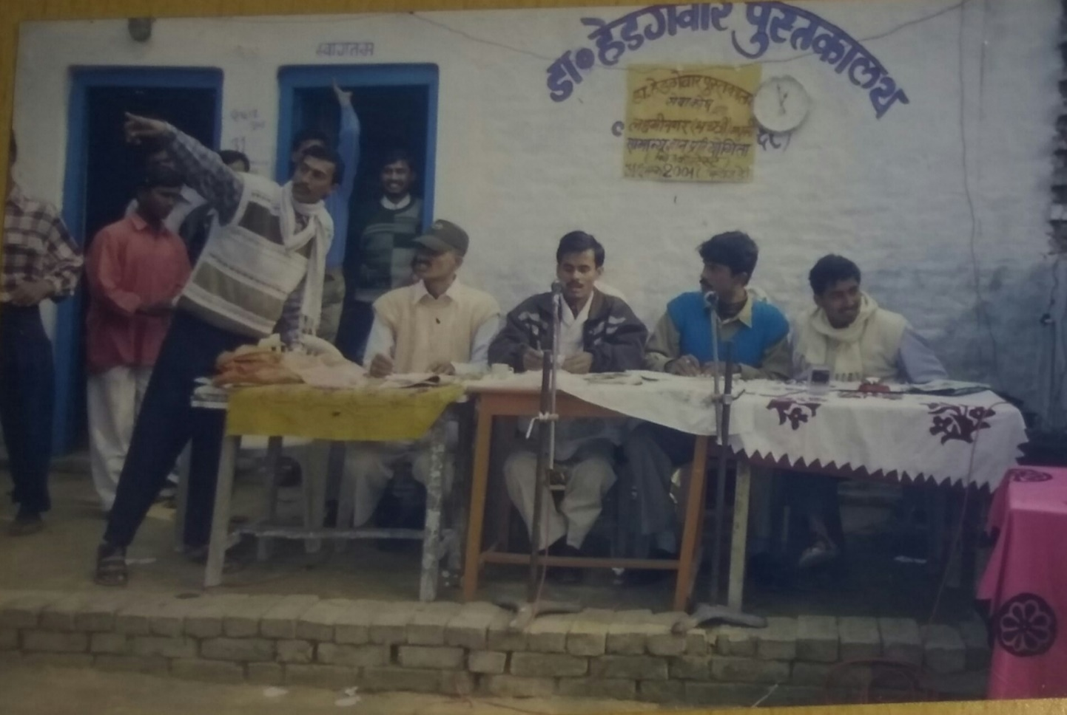
Old is Gold

Slide 30
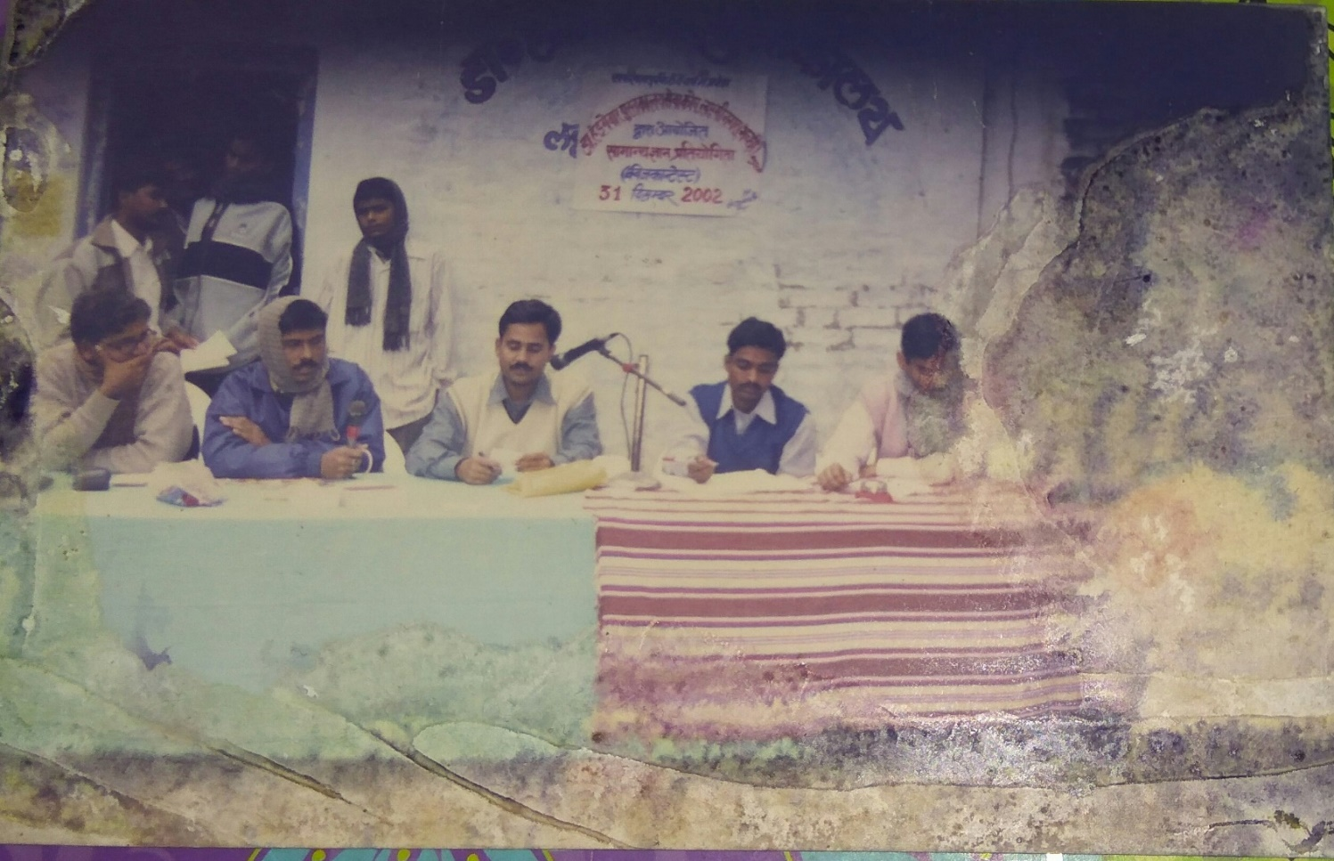
All Organizing committee members are in govt. job Now

Slide 31
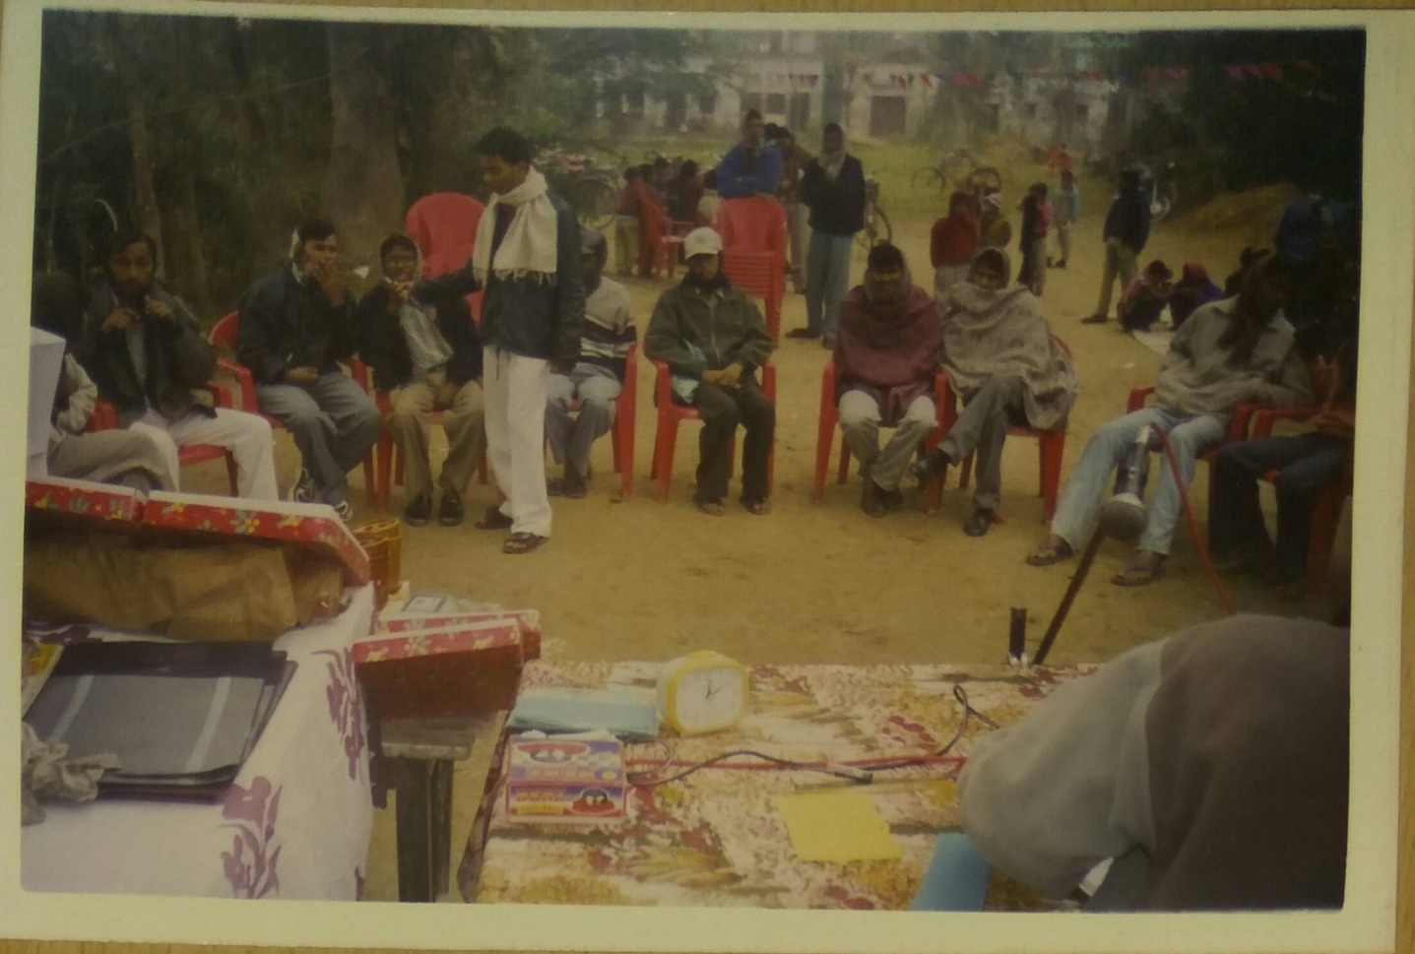
Quiz contest 2003

Slide 32
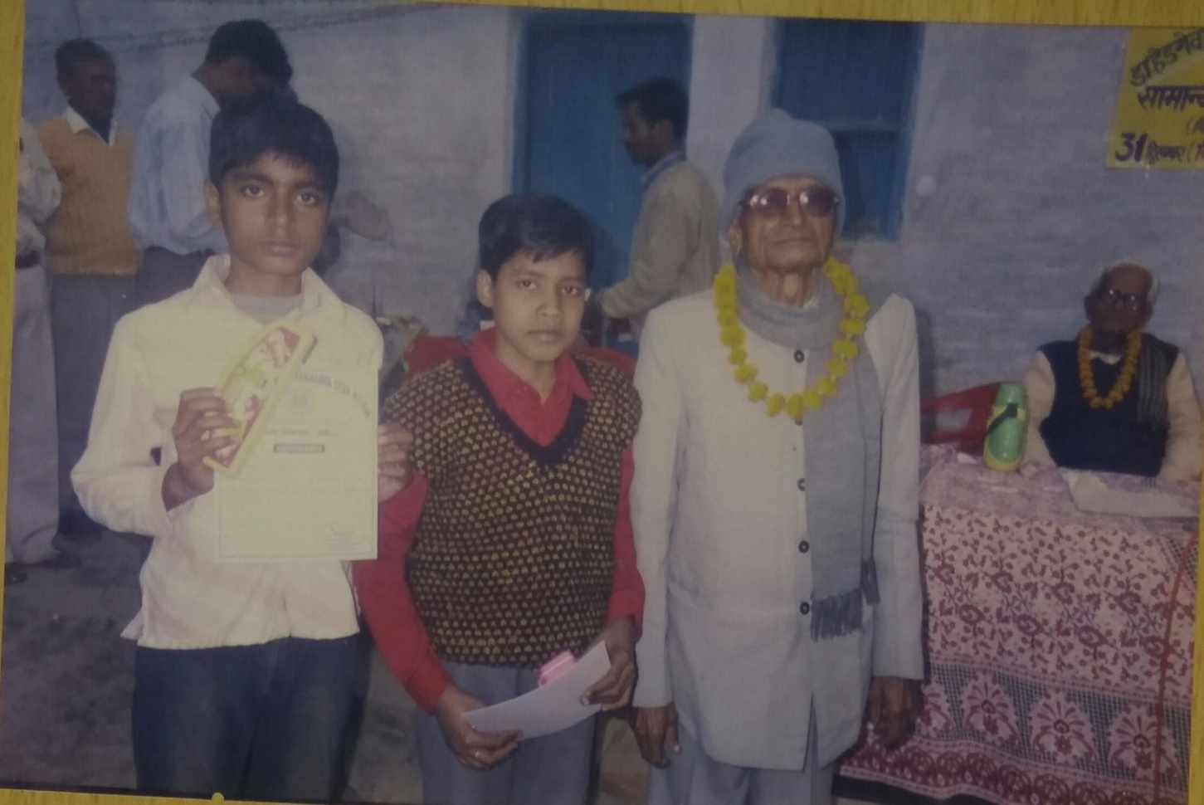
Winners with the MentorS

Slide 33
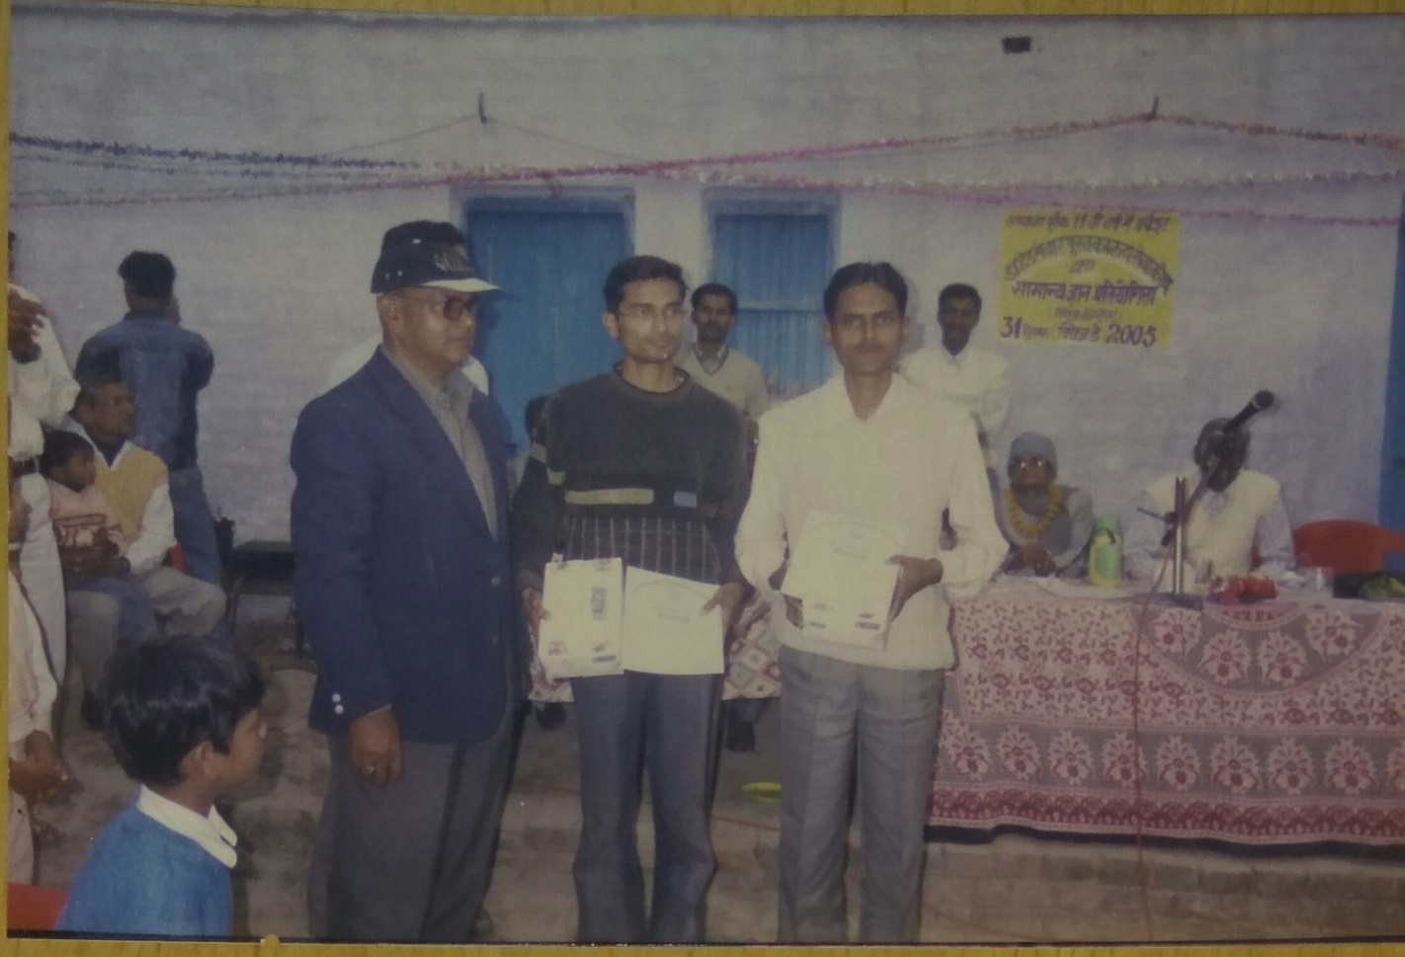
College level winner with guest IN 2005

Slide 34
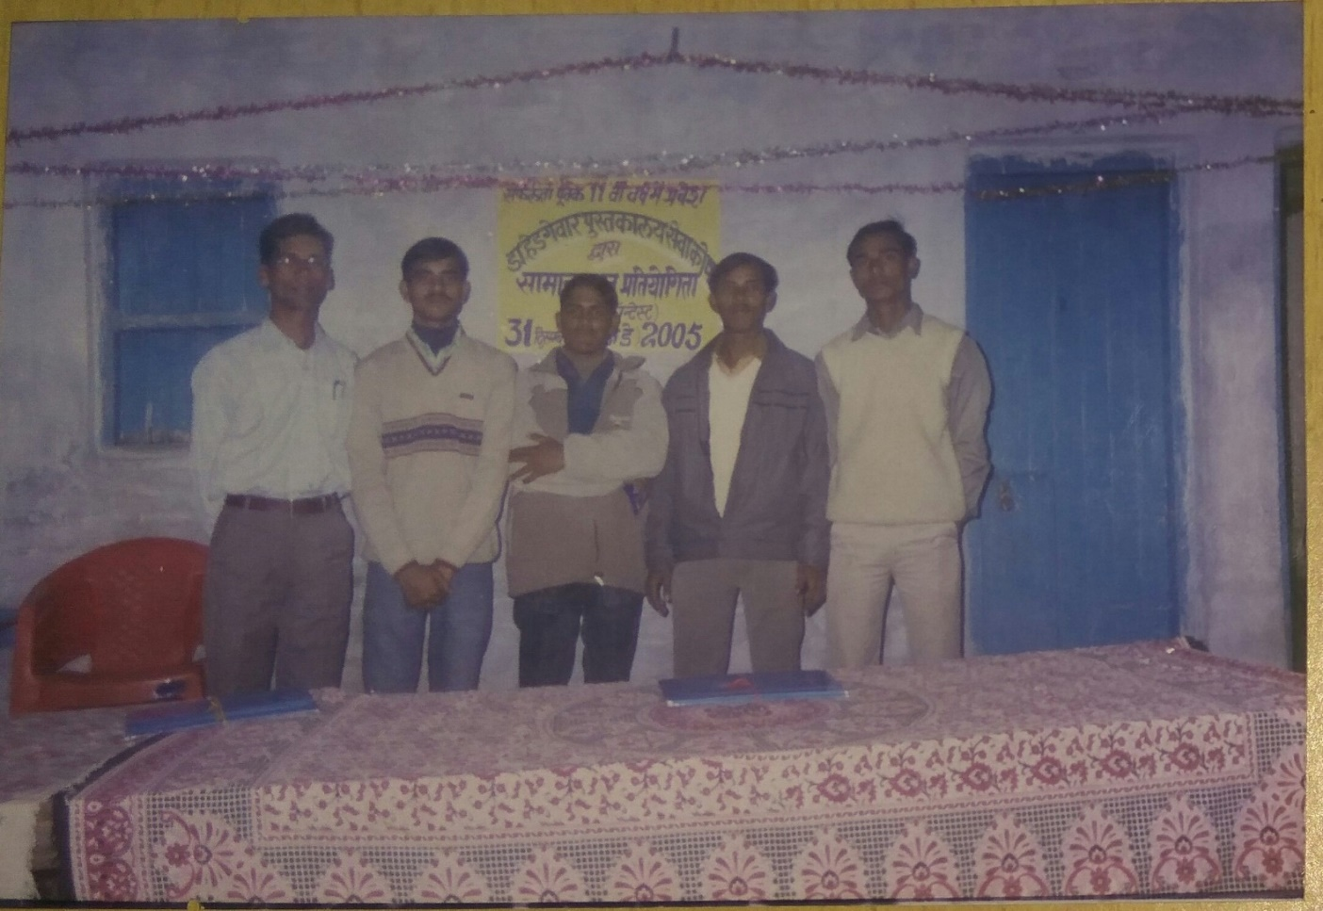
All our members are working in various organizations

Slide 35
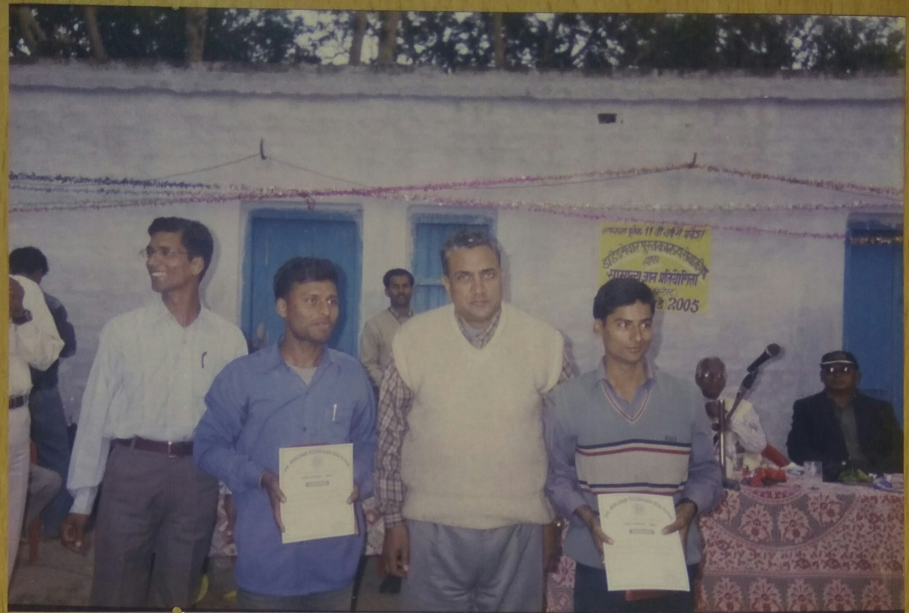
Winners with our Mentor Late Arun kr. Mishra Sir

Slide 36
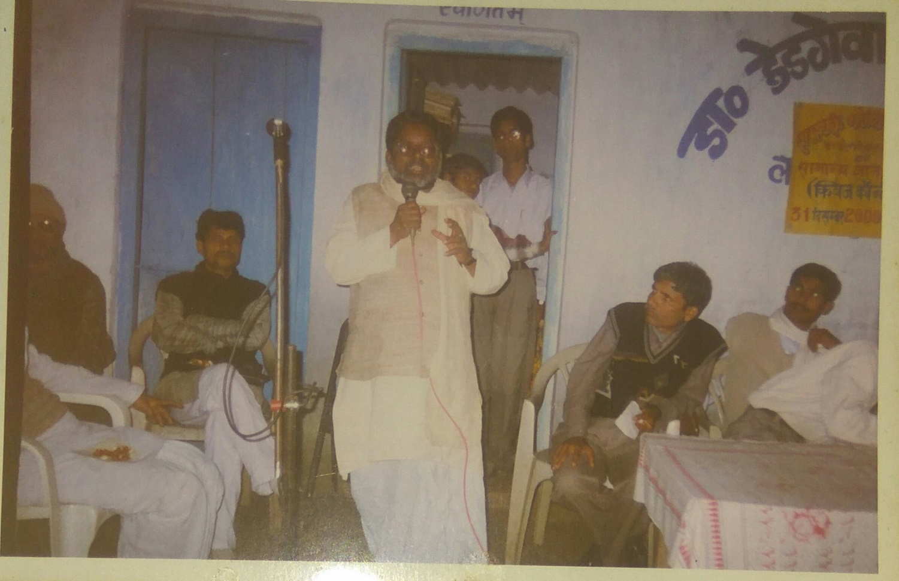
speech by former M.L.A Shri Ramdev Mahto

Slide 37
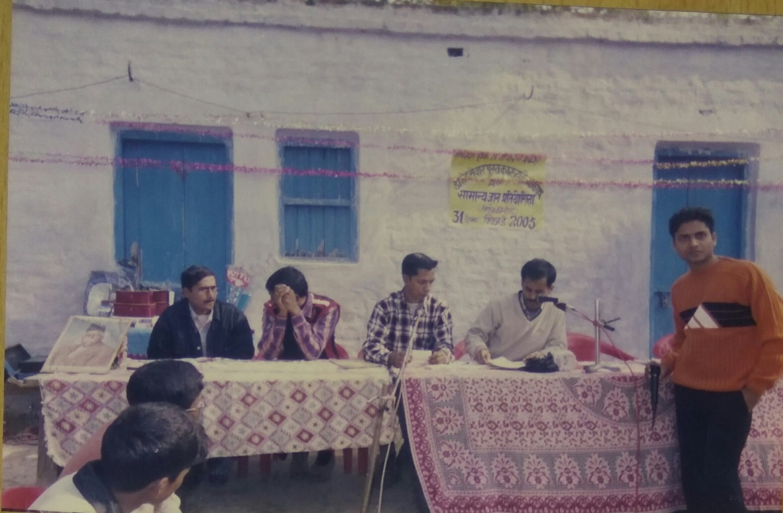
College level round

Slide 38
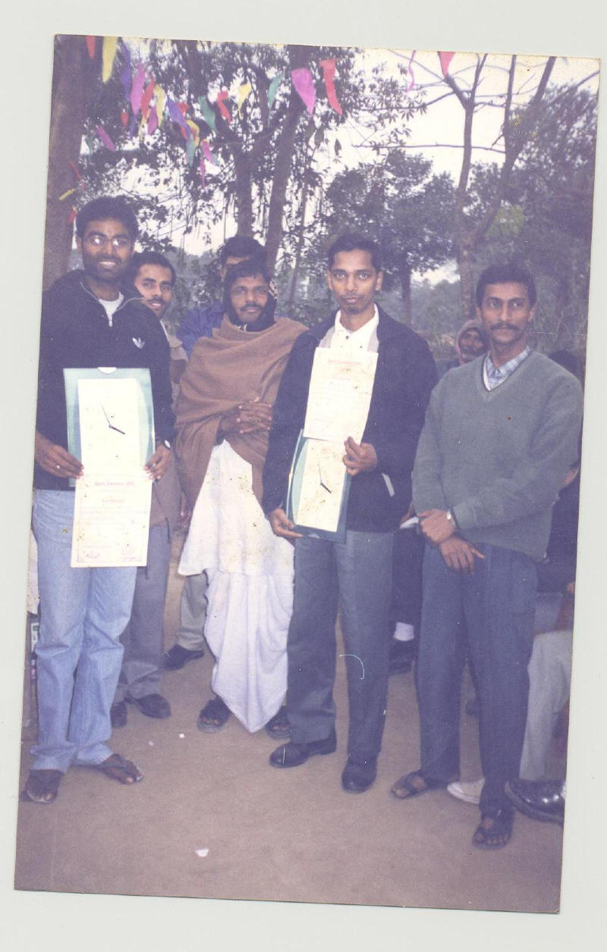
WINNERS OF the QUIZ CONTEST

Slide 39
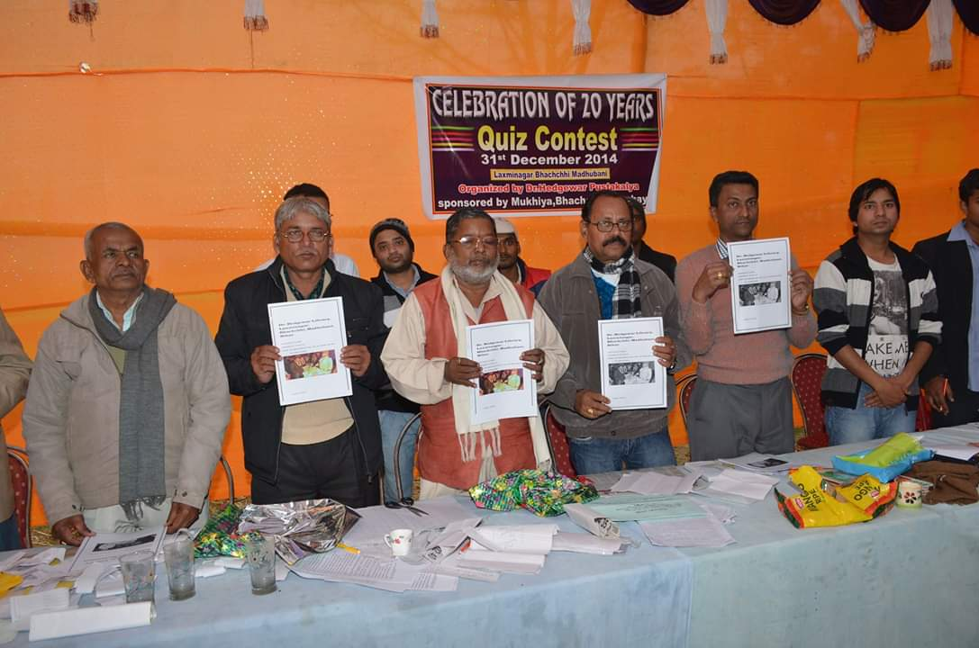
Guest & Members with Booklet 2014

Slide 40
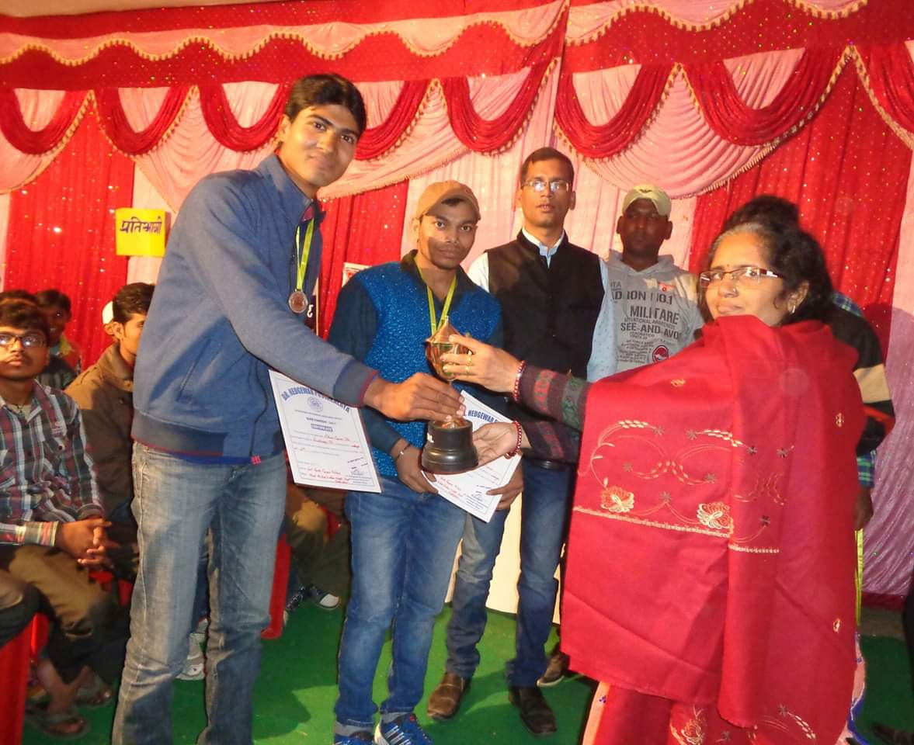
Winners with Smt. Gita Mishra

Slide 41
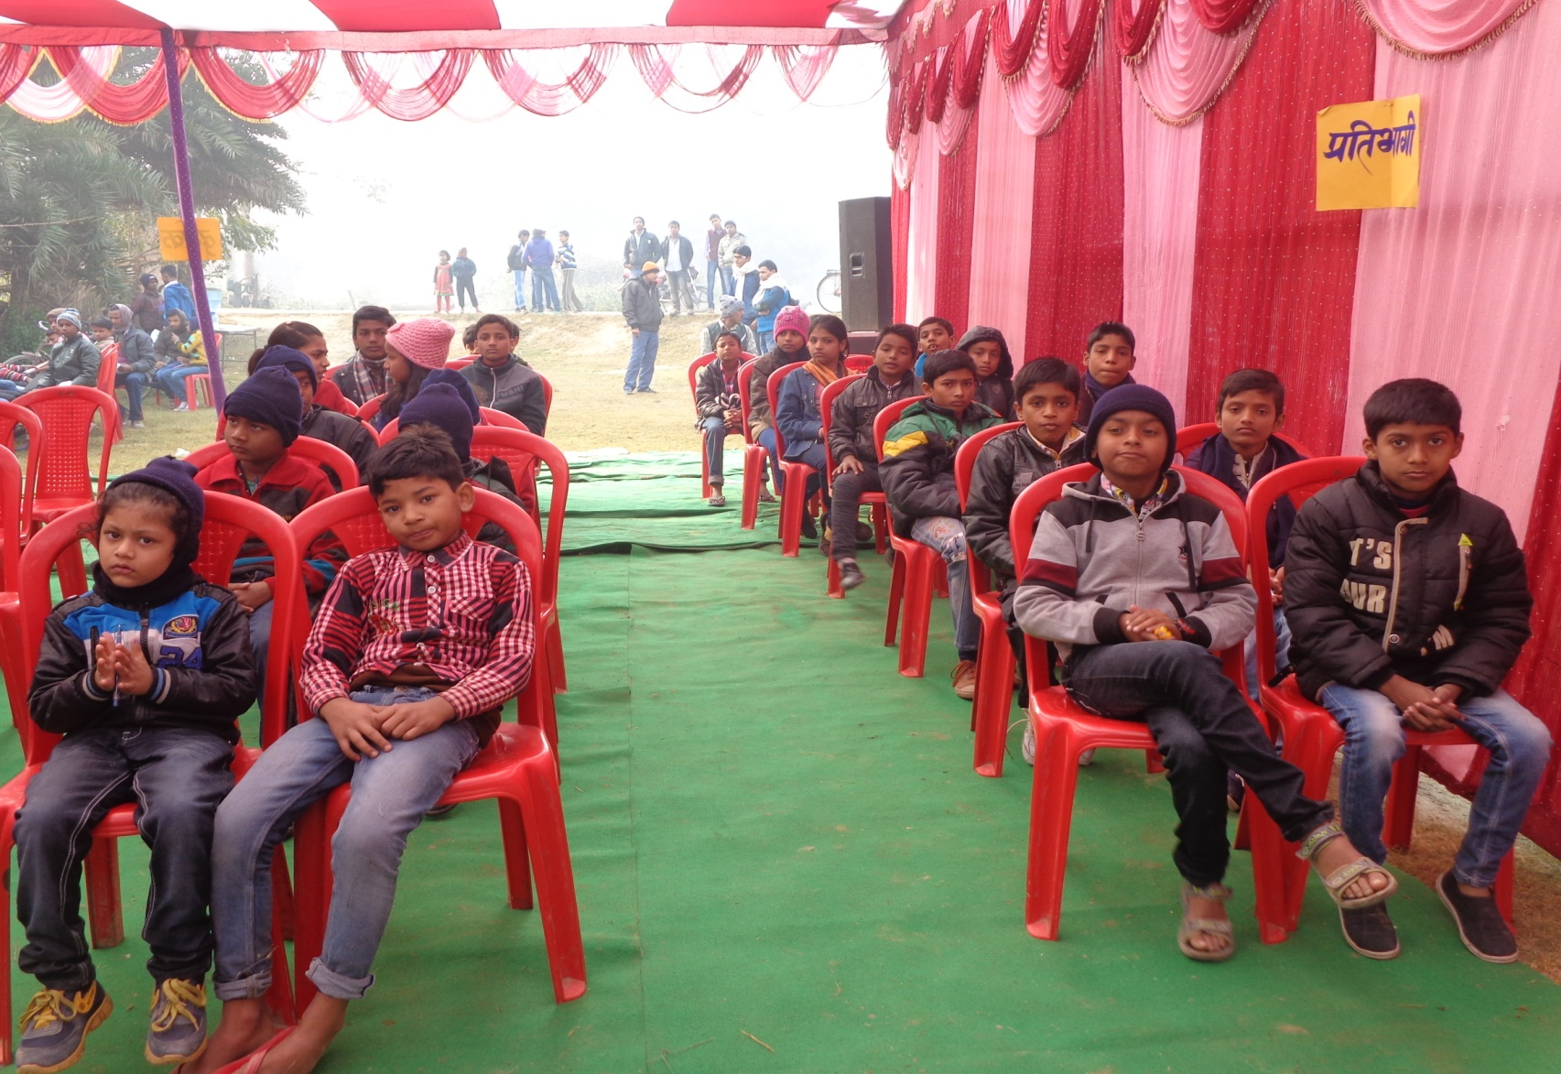
PARTICIPANTS OF QUIZ CONTEST

Slide 42
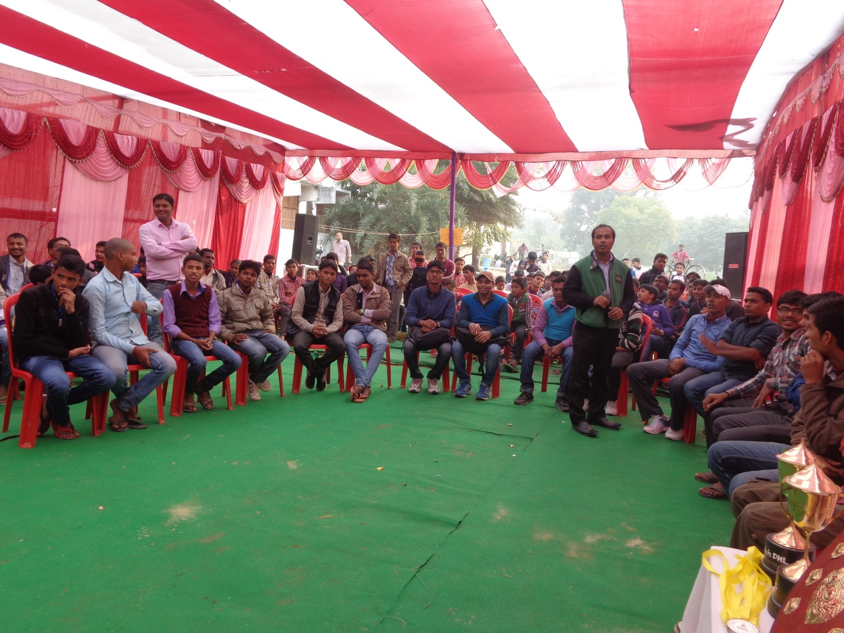
FINAL ROUND OF one of our QUIZ CONTESTs

Slide 43
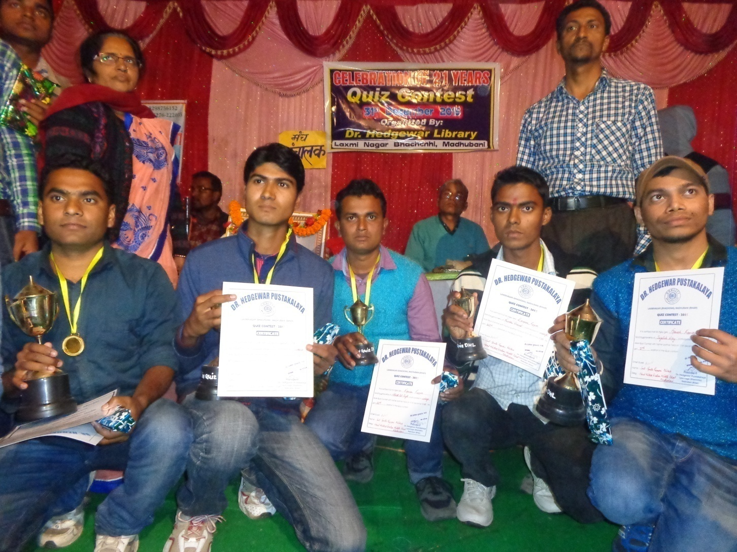
WINNERS of QUIZ CONTEST 2015

Slide 44
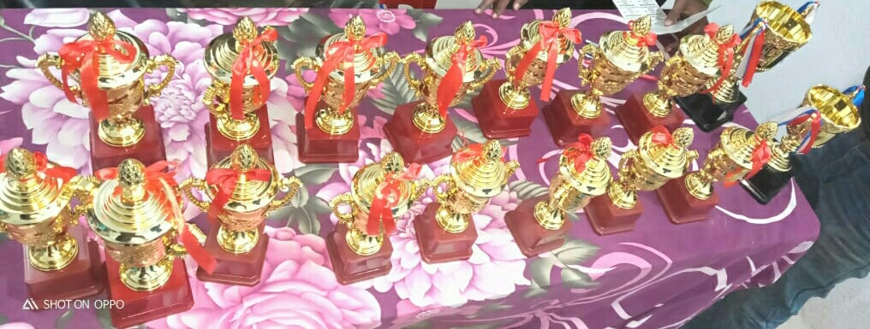
PRIZES IN QUIZ CONTEST

Slide 45
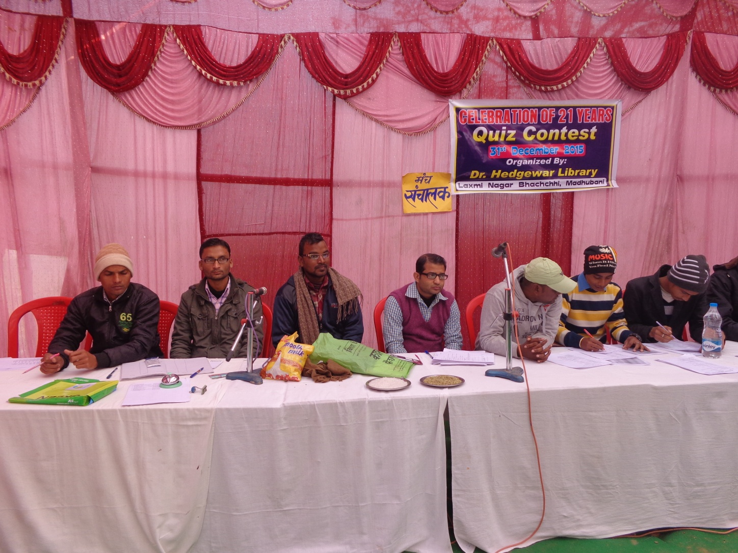
Quiz Contest - 2015

Slide 46
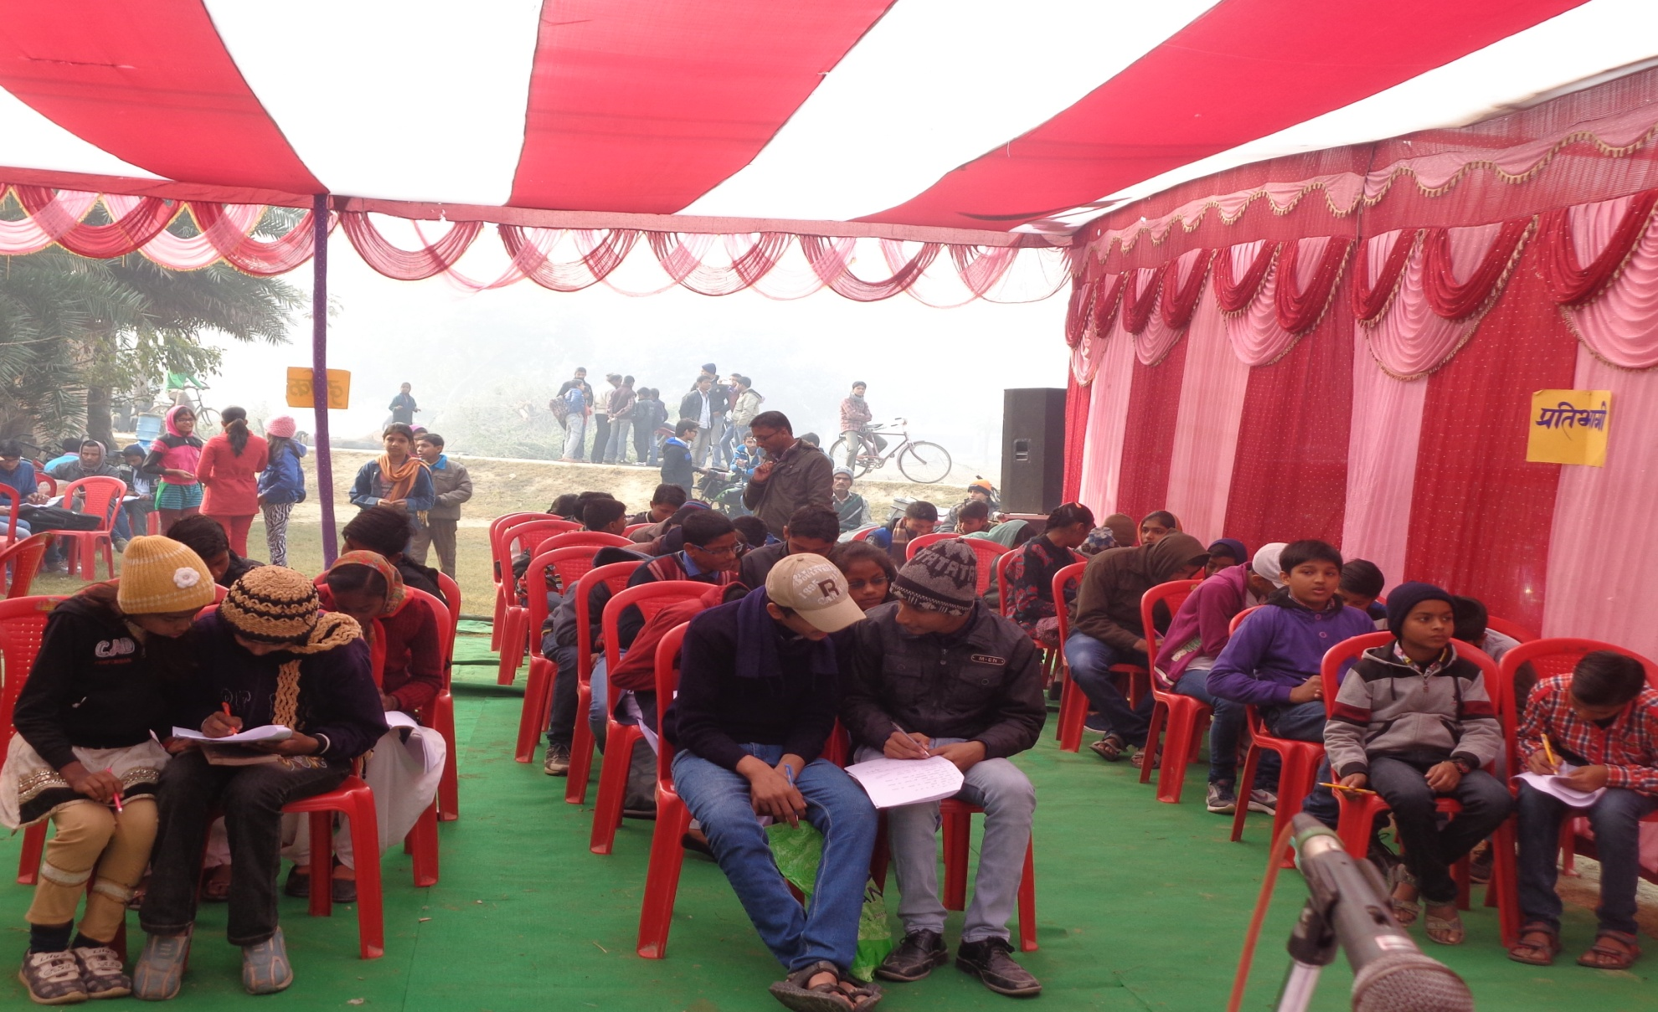
Quiz Contest 2015 (Engaging the audience & contestants alike)

Slide 47
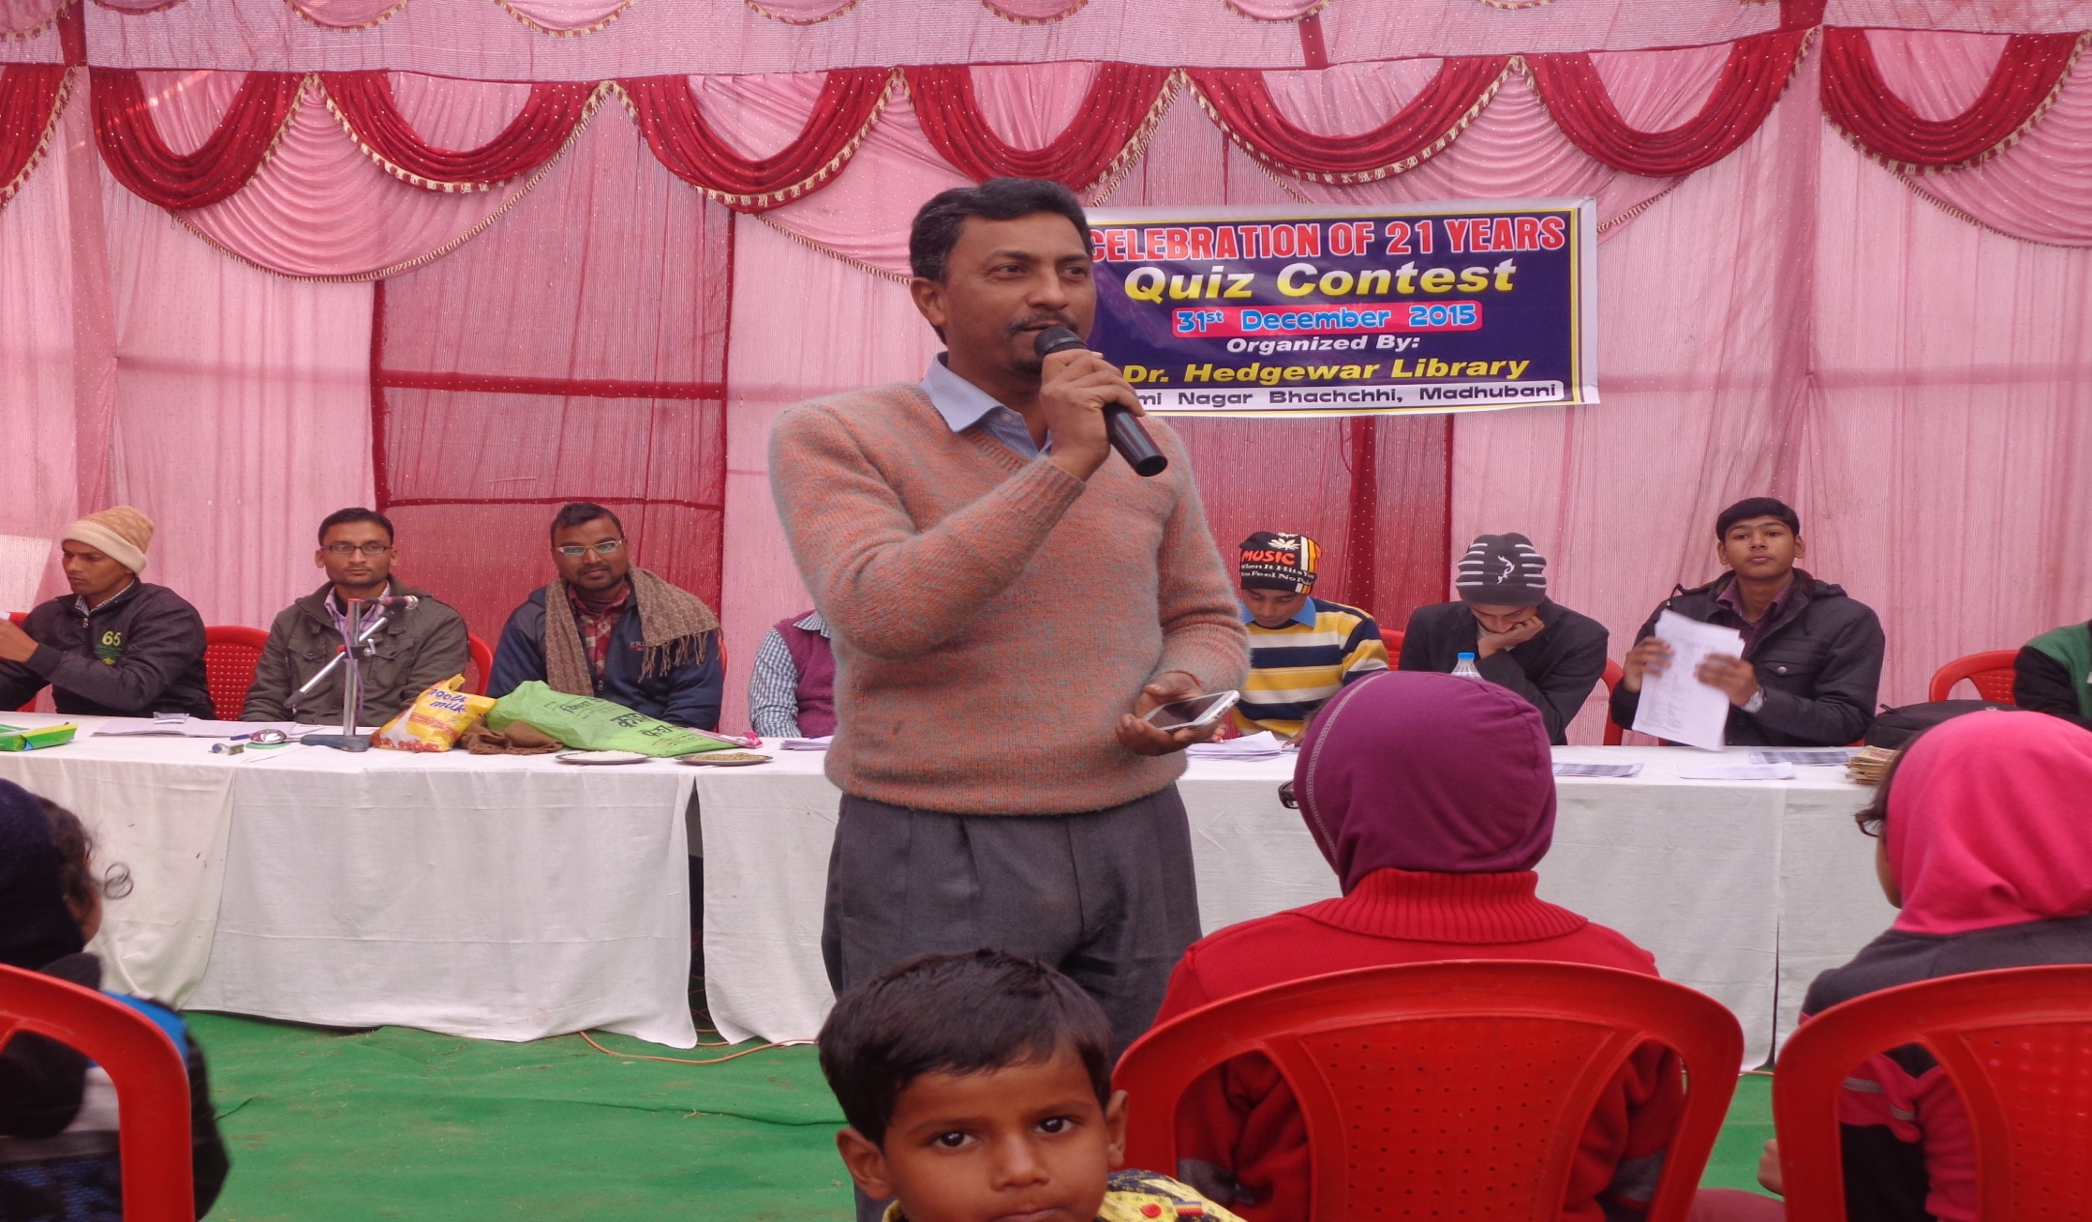
Quiz contest 2015 (Our very own Pawan Sir)

Slide 48
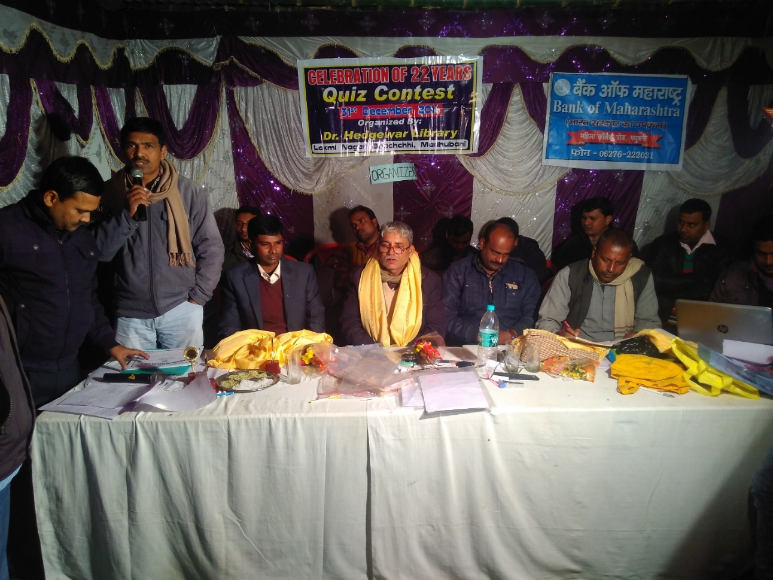
Quiz CONTEST 2016

Slide 49
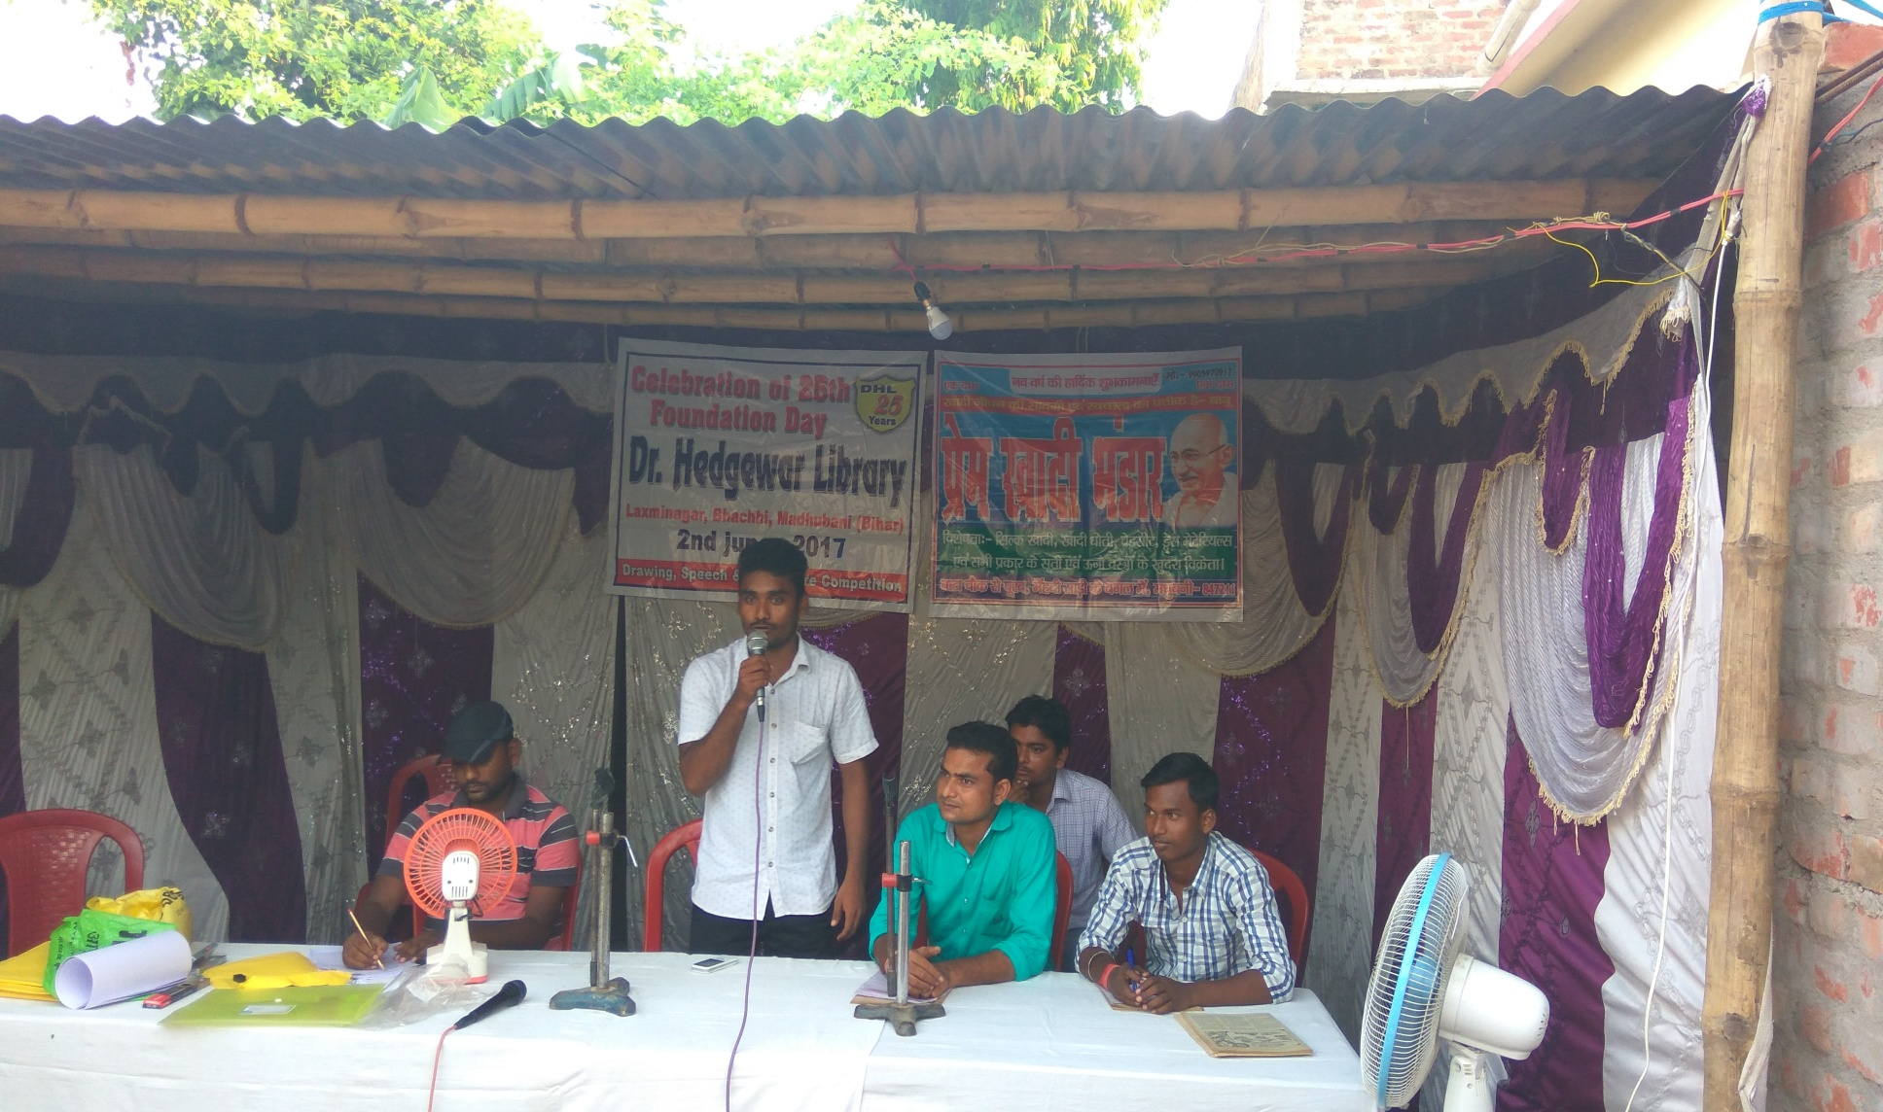
Foundation day, 2nd June 2017

Slide 50
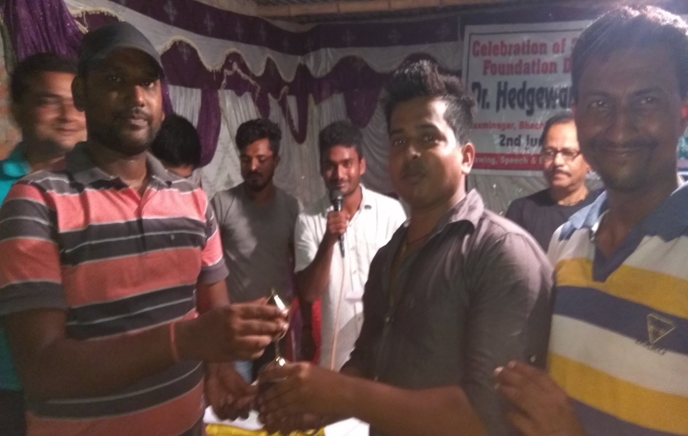
WINNERS Foundation day,2nd June 2017

Slide 51
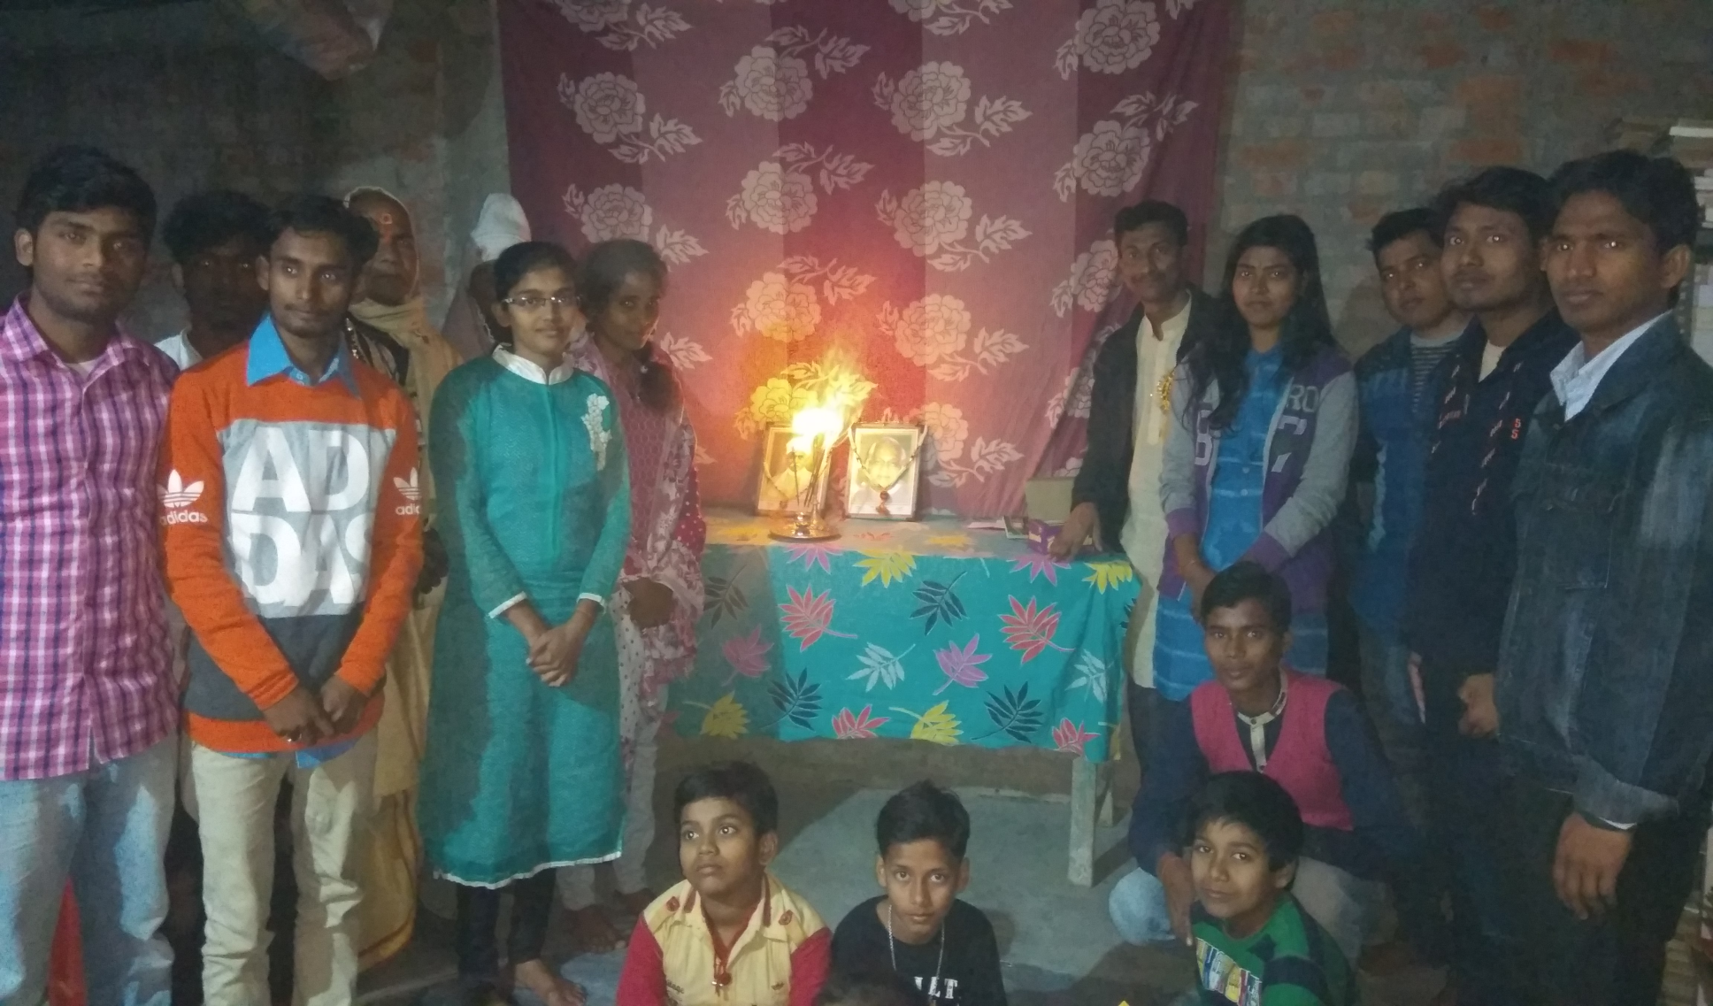
Birthday Celebration of Vajpayee and Malviya ji 25-12-17

Slide 52
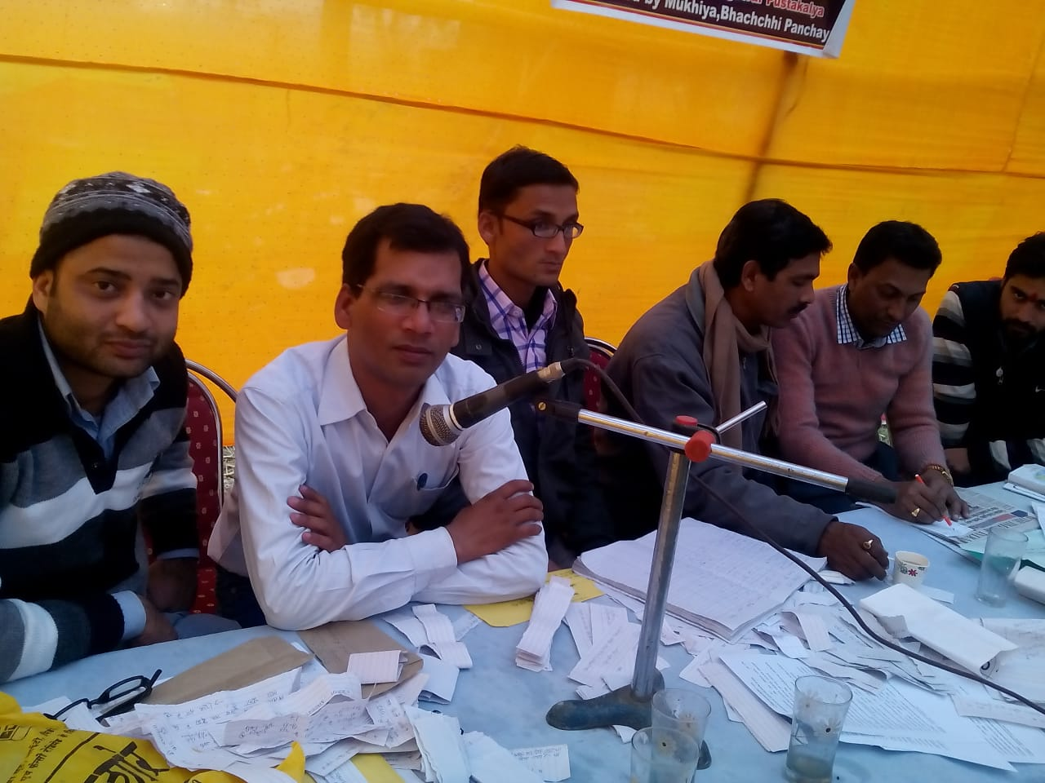
Our busybees

Slide 53

WINNERS OF Quiz Contest 2017

Slide 54

Prize received by Preeti on behalf of her Grand Mother

Slide 55

Quiz Contest-2017

Slide 56

zara Hat kay

Slide 57

Prize Received by ishwar

Slide 58

Prize as Quiz Master Prem

Slide 59

Quiz Contest-2018 SPEECH BY MENTOR ABHAY SIR

Slide 60

A career Counseling session by MENTOR Amitabh ji

Slide 61

Members of the Library IN FREE MOOD MEETING IN 2019

Slide 62

Learners in our Library

Slide 63

Quiz Awareness campaign by members of Library in 2019

Slide 64

SILVER JUBILEE CELEBRATION QUIZ CONTEST IN 2019

Slide 65

FOUNDER SPEECH SILVER JUBILEE CELEBRATION

Slide 66

PRIZE DISTRIBUTION BY MLC MADHUBANI WITH SANJIV JI SILVER JUBILEE CELEBRATION

Slide 67

PRIZE DISTRIBUTION BY PRINCIPAL REGIONAL SCHOOL SILVER JUBILEE CELEBRATION

Slide 68

GUEST AND AUDIENCE SILVER JUBILEE CELEBRATION

Slide 69

SPEECH BY MENTOR MD. KAMRAN SIR SILVER JUBILEE CELEBRATION

Slide 70

HONOUR TO MLC BY FOUNDER SILVER JUBILEE CELEBRATION

Slide 71

PUBLISHed IN NEWS PAPER SILVER JUBILEE CELEBRATION

Slide 72

ONLINE COMPETITION 2020

Slide 73


ONLINE COMPETITION 2020

Slide 74


Slide 75

Winners of 29TH quiz contest Celebration on 31-12-23

Slide 76

WINNERS OF 29th QUIZ CONTEST CELEBRATION ON 31-12-23

Slide 77

ONLINE PARTICIPATION AND CELEBRATION OF 33RD FOUNDATION DAY CELEBRATION ON 02-06-24

Slide 78

WINNERS OF 33RD FOUNDATION DAY CELEBRATION ON 02-06-24

Slide 79


Slide 80


Slide 81


Slide 82


Slide 83


Slide 84
ACHIEVERS
of
DHL

Slide 85

MR. Abhay kumar jha Reservation Supervisor (HQ), DRM Office, Danapur, Patna, Bihar.

Slide 86

MR. Sanjeev Kumar Assistant Section Officer Jharkhand Secretariat, Ranchi

Slide 87

MR. Sudhir Kumar B.D.O. Hanuman Nagar, Darbhanga

Slide 88

Md. Mahtab Ansari BDO, Vidyapati Nagar Samastipur, Bihar

Slide 89

Ashutosh Jha Chief Dealer, SBI New York

Slide 90

Rajesh Kumar Mishra, Superintendent, Central Board of Indirect Taxes and Customs, New Delhi

Slide 91

Kundan Kumar Senior Manager Punjab & Sind Bank Corporate Office East Kidwai Nagar New Delhi

Slide 92

MR. PRAKASH KUMAR SENIOR ACCOUNTANT BANK OF MAHARASHTRA dARBHANGA

Slide 93

Md. Shamshir PGT( GEOGRAPHY) G.M.S.S. HiGHER SECONDARY SCHOOL MADHUBANI

Slide 94

Bharat Bhushan Senior Manager, Business Development Pune City Zone Bank of Maharashtra

Slide 95

Bikash Kumar Designation- Tm4 City- Bhiwandi, Thane District

Slide 96

MR. Mahavir kumar Teacher,Madhubani

Slide 97

Sachin Kumar Yes Bank Ltd Deputy Manager Kapashera Branch New Delhi

Slide 98

Chandan Thakur Joint Manager Bank Of Baroda Jaynagar, Madhubani

Slide 99

V K Vivek Loco Pilot, Railway Nagpur

Slide 100

Rajesh Kumar, Station Master Simri Bakhtiarpur, Bihar

Slide 101

Pawan Kumar Jha Manager Punjab and sind bank, Green park, New Delhi

Slide 102

Prakash Narayan Jha Assistant Vice President Bank of America

Slide 103

Abhinav Kumar Senior consultant at Capgemini

Slide 104
AND
MANY
MORE

Slide 105

Thank you

